Slide 1
Power System Planning
Muhammad Kamran, PhD
Professor, EED, UET
mkamran@uet.edu.pk

Slide 2
Course Evaluation
Quiz (s) 3-4 15%
Mid Term Exam 30%
Assignments 3-4 10%
End Term Exam 40%
Presentations 5%
CLOs will be followed as per course which will be mapped on required PLOs

Slide 3
Text Book
Electric Power Distribution Engineering By Turan Gonen, 2nd Edition
Reference Books and Material: Internet or any other related material
Presentation Guidelines: Any relevant topic with practical implementations in field by the presenters

Slide 4
Lecture Contents
Introduction to Course
Distribution System Planning
Calculations for the Generation planning and cable pricing
Factors Affecting the System Planning
Distribution planning
Basic Definitions

Slide 5
Introduction
An Electric power system includes Generation, Transmission and Distribution of Energy
The electric utility industry grew very rapidly and the generation stations and transmission and distribution networks spread across the entire country
Considering energy needs and available fuels that are forecasted for the next century, energy is expected to be increasingly converted to electricity
Operation and maintenance is major part of power system planning

Slide 6
Distribution System Planning
System planning is essential to ensure the 100% safe and appropriate power system operation
In the past, the planning for the other portions of electric power system and distribution system frequently had been authorized at the company division level without review of or coordination with long range plans
As a result increasing cost of energy, equipment and labor etc is encountered
The distribution system is particularly important to an electrical utility for two reasons; (i) its close proximity to ultimate customer and (ii) its investment cost

Slide 7
If distribution system of power supply system is the closest to customer, its failures affect customer more directly than for example failure on transmission and generating systems, which usually do not cause customer service interruptions
Therefore, distribution system planning starts at the customer level
The demand, type, load factor and other customer load characteristics dictate the type of distribution system required
Load factor calculation is shown in next slide

Slide 8
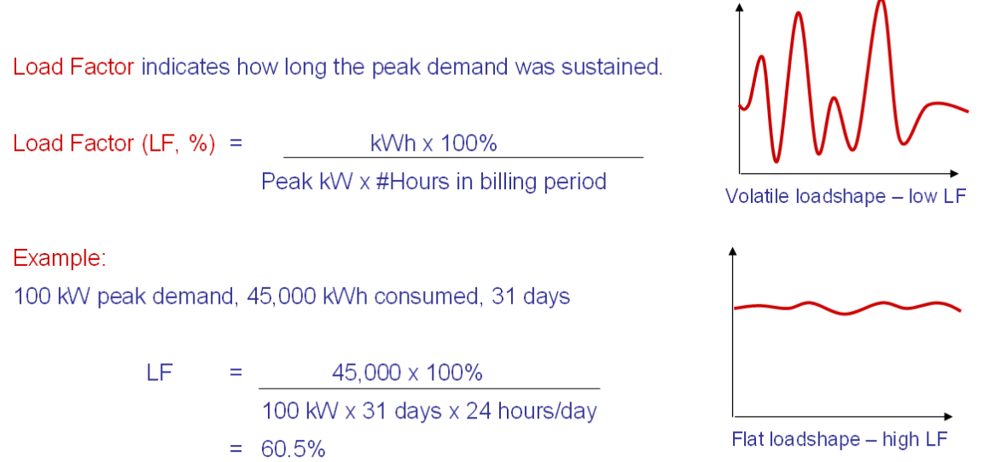
Load Factor

Slide 9
If your peak demand is measured in kVA, you should convert it to kW by multiplying the kVA figure by the on-peak power factor for your building (if you know it)
If not, a power factor of 90% is a reasonable estimate for most buildings that do not have power factor correction capacitors installed
Values for LOAD FACTOR vary widely with the types of loads and operating schedules
Some industrial loads dip to 20% or lower, while commercial buildings commonly see 40% to 70%
Of course, you can expect seasonal swings if you have electric cooling or heating systems.

Slide 10
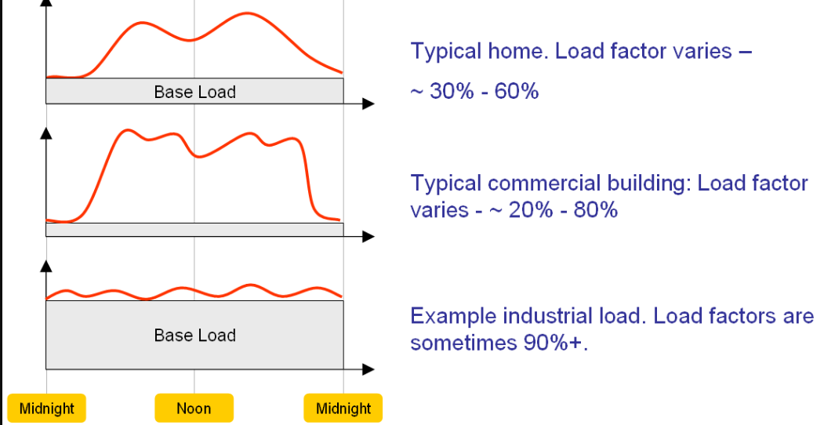

Slide 11
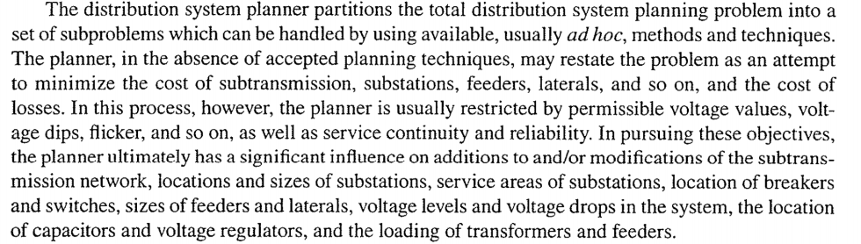
Reference- Text Book

Slide 12
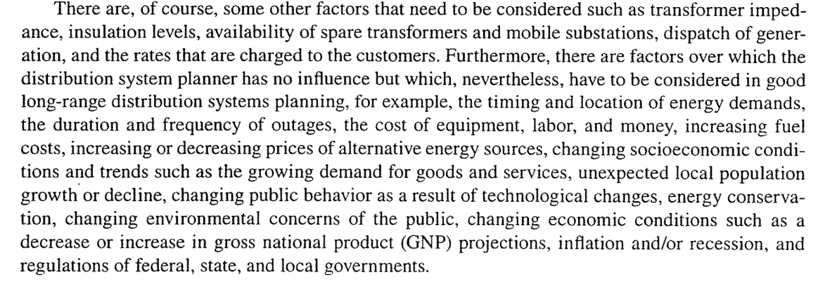
TEXT BOOK

Slide 13
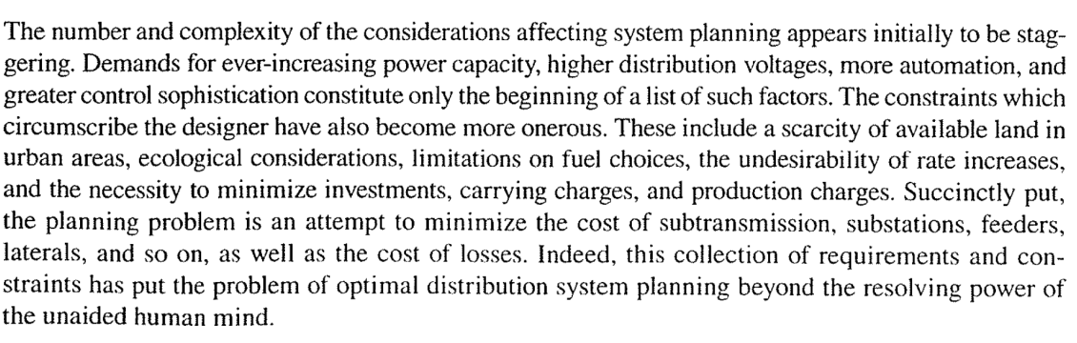
Factors Affecting System Planning

Slide 14
Load Forecasting
The load growth of the geographical area served by a utility company is the most important factor influencing the expansion of the distribution system
Therefore, forecasting of load increases and system reaction to these increases is essential for planning process
Here are two common time scales of importance to load forecasting; long range with time horizon in order of 15-20 year away and short range with time horizon in order of 5 years away
Next slide gives factors affecting Load forecasting;

Slide 15
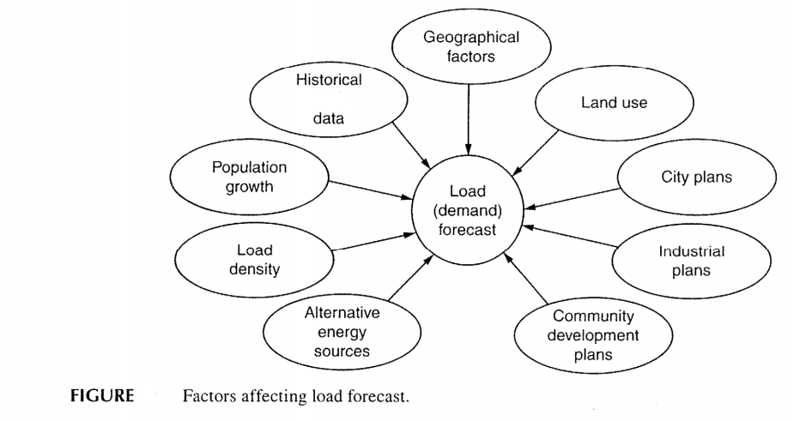

Slide 16
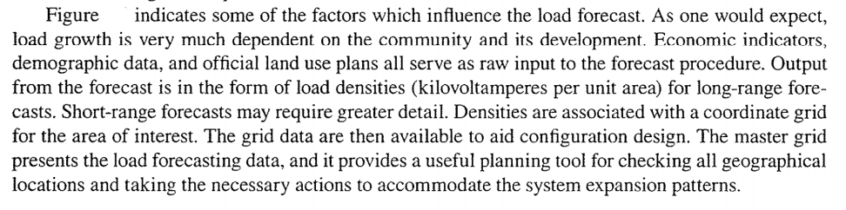
TEXT BOOK

Slide 17
Substation Expansion
Fig in next slide presents some of the factors affecting substation expansion
The planner makes a decision based on tangible or intangible information.
For example, the forecasted load, load density and load growth may require a substation expansion or a new substation construction
For expansion present system configuration, capacity, and the forecasted loads can play major roles

Slide 18
Substation Site Selection
Fig shows factors that affect substation site selection
The distance from load centers and from existing sub transmission lines as well as other limitations, such as availability of land, its cost, and land use regulations are important
Service region is the area under evaluation defined as the territory of the utility
An initial screening is applied by using a set of considerations like safety, engineering system planning, institutional economics etc.

Slide 19
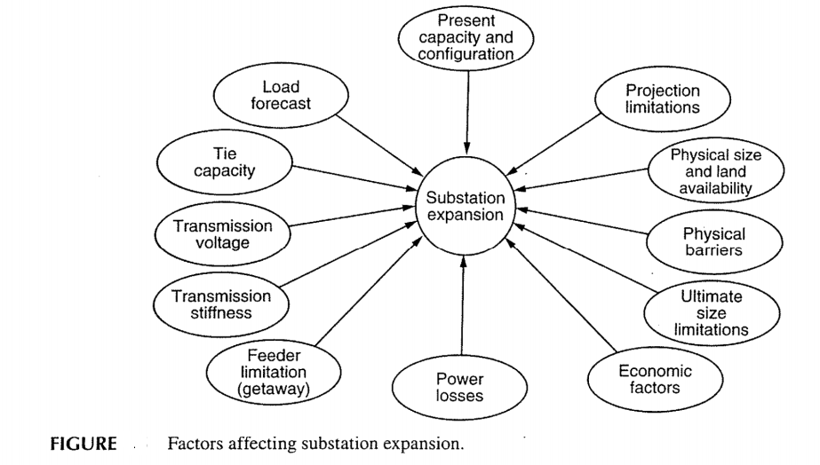

Slide 20
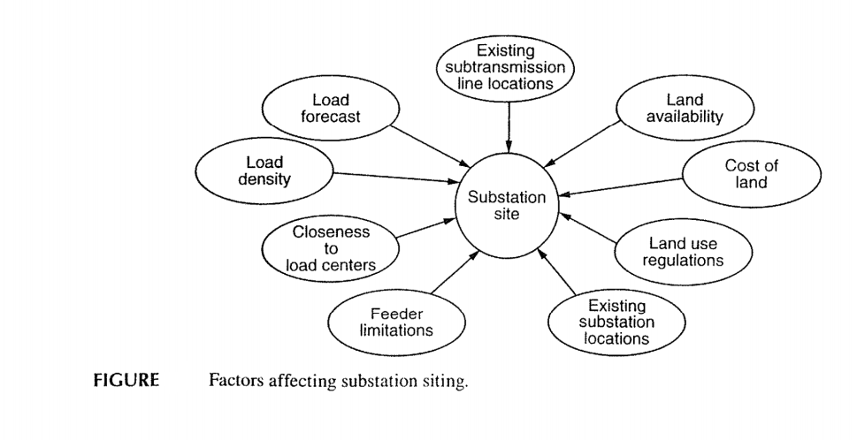

Slide 21
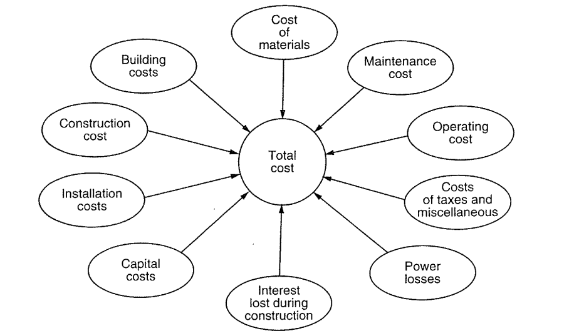
Factors Affecting cost

Slide 22
Distribution system planning- Technical aspects
One of the essential elements in distribution system planning is the location of the load centre where the primary substation is situated
Establishment of load centre or primary substation, particularly in a densely populated area, must be prepared in long-term plan, for example, in a 10-year plan
The outlets from the primary substation will then supply the required electrical energy to the nearby customer loads
Customer substations will then further transform the distribution high voltage to the LV.

Slide 23
Basic Design Criteria
Distribution network refers to those 22kV or 11kV network supplying electricity to customers through cable or Overhead Line (OHL)
From primary substation to various customer substations, various types of network configurations are possible, for example, single-end fed, double-end fed and closed ring network arrangement
In the customer substation, it normally consists of the step down transformer to LV; it may also contain HV circuit breaker(s), ring main units

Slide 24
Additional consideration is the availability of remote control facilities to enhance the security of supply
In transmission network, the typical design concept is the ‘N-1’ reliability application
‘N-1’ is referred to as any single component failure in the supply network will not affect the electricity supply
Hence in the case of a failure of a transmission line, or a transformer connected to the distribution primary substation from the transmission source, the supply to the distribution network will not be affected

Slide 25
It is normally achieved with suitable protection and associated inter-tripping or switching scheme to the distribution incoming from the transmission network
Hence, the primary substation is thus designed to supply a firm load based on the calculation of ‘N-1’ criteria
On the other hand, the distribution network connected from the primary source substation will depends on the geographical locations of the customer substations

Slide 26
Ring Main Unit
In an electrical power distribution system, a ring main unit (RMU) is a factory assembled, metal enclosed set of switchgear used at the load connection points of a ring-type distribution network.
It includes in one unit two switches that can connect the load to either or both main conductors, and a fusible switch or circuit breaker and switch that feed a distribution transformer.
The metal enclosed unit connects to the transformer either through a bus throat of standardized dimensions, or else through cables and is usually installed outdoors.

Slide 27
Ring main cables enter and leave the cabinet
This type of switchgear is used for medium-voltage power distribution, from 7200 volts to about 36000 volts.

Slide 28
Types of Distribution Networks
Single-end radial fed
Single-end radial fed refers to a number of customer substations or pole-mounted substations are connected to the primary substation
The supply security is the lowest as any single point failure will result in the loss of supply to the customer substation
Similarly, any single failure in the customer substation will result in loss of supply to the customer
In case of fault, the supply restoration will depend on the fault repair time.

Slide 29
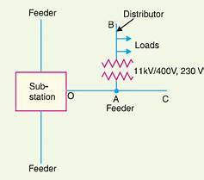

Slide 30
Double-end fed with an NO Point
To provide a higher supply security, the customer substations can be fed from two sources as shown in fig
The customer substation is normally supplied from a single end and in the case of loss of supply from the one source end, for example due to a component failure, the NO (normally open) point can be closed to restore supply after the faulty portion of the component is isolated
The supply restoration will be quicker and is not directly depending on the fault repair time
The customer substation may consist of Ring Main Unit (RMU) and equipped with earth fault indicator as shown below

Slide 31
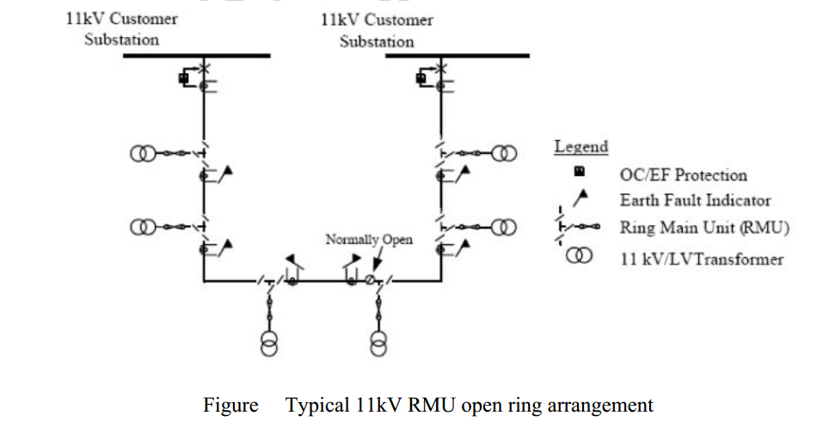
Double-end fed with an NO point

Slide 32
This configuration results in loss of supply in case of fault in the RMU circuit since the controlling circuit breaker at the controlling/customer substation will trip to isolate the faulty circuit

Slide 33
Ringed Network Arrangement
A typical customer substation in a ring-configured network contains two feeders and one transformer feeder
The former have circuit breakers and cable connecting to other substations while the later has circuit breaker and cable connecting to 11kV/LV transformer
A typical ringed network arrangement is shown in fig

Slide 34
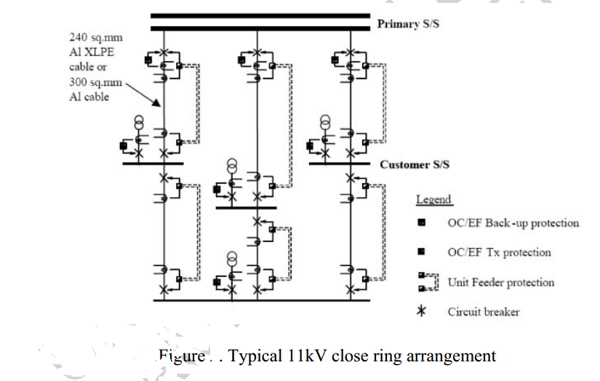

Slide 35
Closed Ring Operation
Closed-ring operation of distribution grids has several advantages over more common distribution grid configurations incorporating normally-open points
As power flows are able to naturally balance out between feeders of a ring shaped distribution grid, it is expected that peak loading will be reduced, and with that, grid losses
As such, investment costs can be postponed or avoided and operational costs can be reduced due to lower grid losses

Slide 36
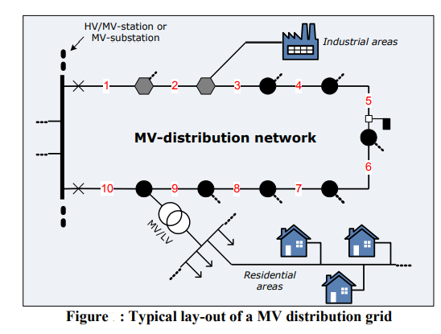

Slide 37
Typically distribution grids are structured according to the lay-out depicted in Figure
Medium voltage distribution rings are usually fitted with a normally-open point (NOP), splitting the ring into two separate feeders from an electrical-technical point of view
The purpose of the NOP is to ensure selectivity for protection systems and reduce the impact of faults in the grid by limiting the number of customers that are affected when protection trips
However, on the downside, the NOP might indirectly incur additional grid losses, by obstructing an optimal power flow

Slide 38
Basic Understanding
To understand some of the problems that the power industry faces let us briefly review some of the characteristic features of generation and transmission
The power system must, be capable of matching the output from generators to the demand at anytime at a specified voltage and frequency
The difficulty encountered in this task can be imagined from the fact that load variations over a day comprises three components-a steady component known as base load; a varying component whose daily pattern depends upon the time of day; weather, season, a popular festival, etc. and a purely randomly varying component of relatively small amplitude

Slide 39
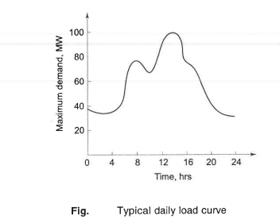
Figure shows a typical daily load curve.
The characteristics of a daily load curve on a gross basis are indicated by peak load and the time of its occurrence and load factor defined as;
Average load/ maximum (peak) load = less than unity

Slide 40
The average load determines the energy consumption over the day, while the peak load along with considerations of standby capacity determines plant capacity for meeting the load
A high load factor helps in drawing more energy from a given installation

Slide 41
Tariff Calculation
Problem 1 Comparing two tariffs of industrial load….

Slide 42
Discussion will be continued…..diversity factors and problems related to average load, installed capacity base load etc.

Slide 43
Power System Planning
Lecture No. 2
Muhammad Kamran, PhD
mkamran@uet.edu.pk

Slide 44

Lecture Contents
Terminologies and problems for power system planning
Diversity factor
Tariff
Load forecasting
Structure of power system

Slide 45
Diversity Factor
This is defined as the sum of individual maximum demands on the consumers divided by the maximum load on the system
This factor gives the diversification of the load and is used to decide the installation of sufficient generating and transmission plants
If all demands came at the same time i.e., unity diversity factor, the total installed capacity required would be much more
Luckily, the factor is much higher than unity, especially for domestic loads
High diversity factors may be provided if;

Slide 46
Giving incentives to farmers and/or some industries to use electricity in the night or light load period
Using day light saving as in many other countries
Staggering the office timings
Having different time zones in the country like USA, Australia, etc.
Having two-part tariff in which consumer has to pay an amount dependent on the maximum demand he makes, plus a charge of each unit energy consumed
Some times consumer is charged on the basis of KVA demand instead used frequently of kW to penalize loads of low power factor
Two other frequently used factors are;

Slide 47
plant capacity factor = Actual Energy Produced/Max possible energy which could be produced
=Average Demand/ Installed Capacity
Plant use factor = Actual Energy Produced/ Plant Capacity (KW) X Time (hrs) the plant has been in operation
Diversity and Demand factor is calculated in next slide

Slide 48
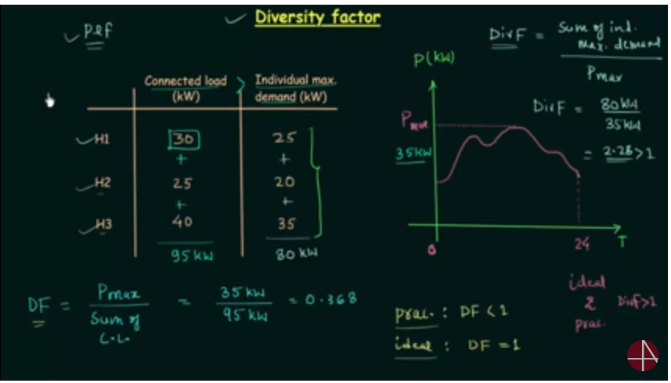

Slide 49
Tariffs
The cost of electric power is normally given by the expression; $a+b X Kw+C X KWh$ per annum, where “a” is fixed charges “b” depends upon maximum demand on the system hence on the interest and depreciation on the installed power stations and “C” depends on the units produced and therefore, on fuel charges and the wages of the station staff
Tariff structures may be such as to influence the load curve and to improve the load factor
Tariff should consider the pf of the load of the consumer
If it is low, it takes more current for the same KWs and hence T and D (Transmission and Distribution) losses are correspondingly increased

Slide 50
The power station has to install either pf improvement devices such as synchronous capacitors, SVC or voltage regulating equipment to maintain the voltages with in allowed limits and thus total cost increases
One of the following alternatives may be used to avoid low pf;
(i) to charge the consumers based on KVA rather than KW
(ii) a pf penalty clause may be imposed on the consumer
(iii) the consumer may be asked to use shunt capacitors for improving the power factor of his installation

Slide 51
Problems…..
Problem 1 …Tariff Calculation
Problem 2….Generation plant calculations

Slide 52
Load Forecasting
As power plant planning and construction require a gestation period of four to eight years or even longer for the present day power stations, energy and load demand forecasting plays a crucial role in power system studies
For long range forecasting, simple extrapolation techniques are adopted
Weather has more effect on residential forecasting as compare to industrial
Both power and energy forecasts are made
In short-term load forecasting, hour-by-hour predictions are made for the particular day under consideration

Slide 53
A minor forecast error on low side might indicate the use of inefficient, oil fired turbine generators
On the other hand, a high side forecast error would keep excessive generation in hot reserve
Accuracy of 1% is desirable
A temperature difference of 2 degree C can vary the total load by 1%
This indicates the importance of reliable weather forecast to a good load forecast

Slide 54
Definition of reserves
In a very simple words suppose a plant having 250 MW capacity in which initially 50 MW was reserved and the rest of 200 MW i.e. plant capacity from this the maximum demand is 150 MW.
Now the 150 MW is cold reserve, 200MW is hot reserve and (200-150) = 50 MW is spinning reserve initially 50 MW saved was firm power.

Slide 55
Regression methods are used to obtain short term load forecast which is very important and is required before solving unit commitment and economical load dispatch problems

Slide 56
Structure of Power systems
Generating stations, transmission lines and the distribution systems are the main components of an electric power system
Generating stations and distribution systems are connected through transmission lines which also connect one power system to another
Distribution system connects all the loads in a particular area to the transmission lines
The siting of hydro stations is determined by the natural water power sources.
The choice of site for coal fired thermal stations is more flexible.

Slide 57
The following two alternatives are possible;
1- power stations may be built close to coal mines (called pit head stations) and electric energy is evacuated over transmission lines to the load centres.
2- power stations may be built close to the load centres and coal is transported to them from the mines by rail road
In practice, however, power stations siting will depend upon many factors like technical, economical and environmental
As it is considerably cheaper to transport bulk electric energy over extra high voltage transmission lines than to transport equivalent quantities of coal over rail road

Slide 58
As nuclear stations are not constrained by the problems of fuel transport and air pollution, a greater flexibility exists in their siting, so that these stations are located close to load centres while avoiding high density pollution areas to reduce the risks, however remote, of radioactivity leakage
Electric power is generated at a voltage of 11 to 25 kV which then is stepped up to the transmission levels in the range of 66 to 765 kV
Voltages are expected to rise to 800 kV in the near future

Slide 59
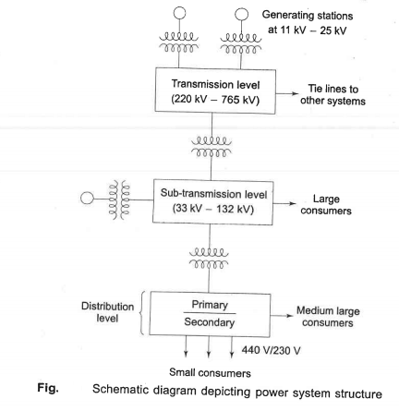

Slide 60
The first stepdown of voltage from transmission level is at the bulk power substation, where the reduction is to range of 33 to 132 KV depending on transmission line voltage
Next step down voltage is at distribution substation
11 KV/440V three phase and 230 volts single phase

Slide 61
Conventional Sources of Electric Energy
Thermal and hydro generations are the main conventional sources of Electric energy
The necessity to conserve fossil fuels has forced scientists and technologists across the world to search for unconventional sources of electric energy
Some of the sources being explored are solar, wind and tidal
The conventional and some of the unconventional sources and techniques of energy generation are briefly surveyed here with a stress on future trends

Slide 62
Thermal Power Stations
The heat released during the combustion of coal, oil or gases used in a boiler to raise steam
Heat generation is mostly coal based except in small sizes, because of limited indigenous production of oil
Therefore, coal-fired boilers for raising steam to be used in a turbine for electric generation
The chemical energy stored in coal is transformed into electric energy in thermal power plants
The heat released by the combustion of coal produces steam in a boiler at high pressure and temperature, which when passed through a steam turbine gives off some of its internal energy as mechanical energy

Slide 63
The axial-flow type of turbine is normally used with several cylinders on the same shaft
The steam turbine acts as a prime mover and drives the electric generator (alternator)
A simple schematic diagram of a coal fired thermal plant is shown in Fig. in next slide; pulvirizer is used for grind coal

Slide 64
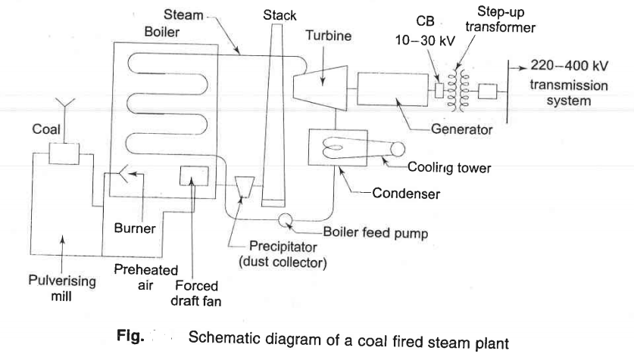

Slide 65
The efficiency of the overall conversion process is poor and its maximum value is about 40% because of the high heat losses in the combustion gases and the large quantity of heat rejected to the condenser which has to be given off in cooling towers or into a stream/lake in the case of direct condenser cooling
The steam power station operates on the Rankine cycle modified to include superheating, feed water heating, and steam reheating
Thermal efficiency can be increased by using steam at highest possible pressure and temperature

Slide 66
Rankine Cycle
The Rankine cycle is an idealized thermodynamic cycle of a heat engine that converts heat into mechanical work while undergoing phase change
The efficiency of the Rankine cycle is limited by the high heat of vaporization of the working fluid
This gives a theoretical maximum Carnot efficiency for the steam turbine alone of about 63.8% compared with an actual overall thermal efficiency of up to 42% for a modern coal-fired power station

Slide 67
With steam turbines of this size, additional increase in efficiency is obtained by reheating the steam after it has been partially expanded by an external heater
The reheated steam is then returned to turbine where it is expanded through final state
Air and thermal pollution is always present in a coal fired steam plant
The air polluting agents are emitted via exhaust gases and thermal pollution is due rejected heat transferred from condenser to cooling water
Cooling towers are used in situations where the stream/lake cannot withstand the thermal burden without excessive temperature rise
The problem of air pollution can be minimized through scrubbers and electro-static precipitators and by resorting to minimum emission

Slide 68
With increasing availability of natural gas prime movers based on gas turbines have been developed on the lines similar to those used in aircraft
Gas combustion generates high temperature and pressure so that the efficiency of gas turbine is comparable to that of steam turbine
Additional advantage is that the exhaust gas from the turbine still has sufficient heat contents, which is used to raise steam to run a conventional steam turbine coupled to a generator
This is called combined cycle gas turbine (CCGT) as shown in fig in next slide;

Slide 69
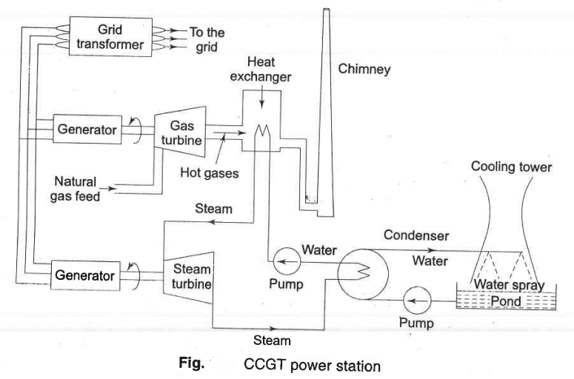

Slide 70
A heat exchanger is a device used to transfer heat between two or more fluids
The fluids may be separated by a solid wall to prevent mixing or they may be in direct contact
The CCGT plant has a fast start of 2-3 min for the gas turbine and about 20 min for the steam turbine
Local storage tanks of gas can be used in case of gas supply interruption
The unit can take up to 10% over load for short periods of time to take care of any emergency
CCGT unit produces 55% of CO2 by a coal/oil fired plant

Slide 71
Hydro electric power generation
The oldest and cheapest method of power generation is that of utilizing the potential energy of water
The energy is obtained almost free of running cost and is completely pollution free
But it involve high capital cost due to heavy civil engineering work
It involves long gestation period of about five to eight years as compared to four to six years for steam plants
Such plants are multipurpose such as river flood control, storage of irrigation and drinking water etc.

Slide 72
A simple block diagram of hydro plant is shown in next slide
The vertical difference between upper reservoir and tail race is called the head
Hydro plants are of different types such as run-of-river (use of water as it comes), pondage (medium head) type, and reservoir (high head) type.
The reservoir type plants are the ones which are employed for bulk power generation
Often, cascaded plants are also constructed, i.e., on the same water stream where the discharge of one plant becomes the in flow of a down stream plant

Slide 73
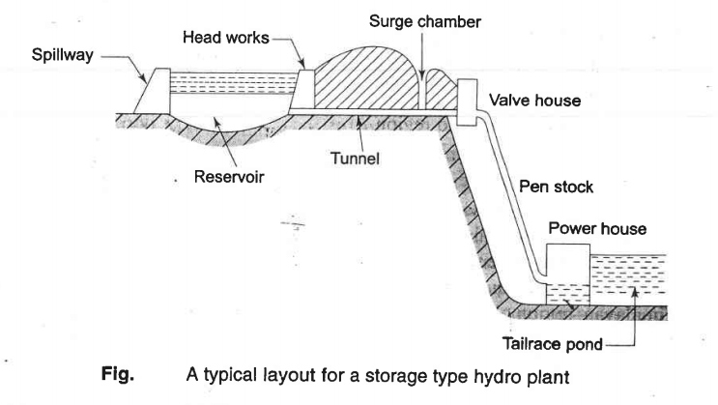

Slide 74
Different types of turbines such as Pelton, Francis and Kaplan are used for storage, pondage and run-of-river plants, respectively
Hydroelectric plants are capable of starting very fast like in five min
The rate of taking up the load on machines is of order of 20 MW/min
Hydro plants are ideal for meeting peak loads
The power available from hydro plant is;
$P=gρWH watts;$
Where W= discharge m³/s through turbine; $ρ$= density 1000 kg/m³
H= Head in meter and g= 9.81 m/sec²

Slide 75
Problems peculiar to hydro plant which inhibit expansion are: 1. Silting-It refers both to the increased concentration of suspended sediments, and to the increased accumulation (temporary or permanent) of fine sediments on bottoms where they are undesirable. 2. Seepage-Seepage Through Earthen Dams (Wet areas downstream from dams are not usually natural springs, but seepage through or under the dam. ... Seepage becomes a concern if it is carrying material with it, and should be controlled to prevent erosion of the embankment, or foundation, or damage to concrete structure) 3. Environmental damage to region 4. Displacement of human habitation from areas behind the dam which will fill up and become a lake

Slide 76
Problem -3
Hybrid Electricity generation and cost analysis

Slide 77
Power System Planning
Muhammad Kamran, PhD
Lecture-3
mkamran@uet.edu.pk

Slide 78
Lecture contents
Renewable Energy resources-Unconventional Energy sources

Slide 79
Renewable Energy Sources
To protect environment and for sustainable development, the importance of renewable energy sources can not be negated
It is an established and accepted fact that renewable and non-conventional forms of energy will play an increasingly important role in future as they are cleaner and easier to use and environmentally friendly and are bound to become economically more viable with increased use
Because of the limited availability of coal, there is considerable international effort into the development of alternative/new/non-conventional renewable/clean sources of energy

Slide 80
Wind Power
Winds are essentially created by the solar heating of the atmosphere
Several attempts have been made since 1940 to use wind to generate electric energy and development is still going on
However, techno economic feasibility has yet to be satisfactorily established
Wind as a power source is attractive because it is plentiful, inexhaustible and non-polluting
Further, it does not impose extra heat burden on the environment
Unfortunately, it is non-steady and undependable

Slide 81
Control equipment has been devised to start the wind power plant when ever the wind speed reaches 30 km/hr
Methods have also been found to generate constant frequency power with varying wind speeds and consequently varying speeds of wind mill propellers
Wind power may prove practical for small power needs in isolated sites
But for maximum flexibility, it should be used in conjunction with other methods of power generation to ensure continuity

Slide 82
For wind power generation, there are three types of operations: 1. Small, 0.5-10 kW for isolated single premises 2. Medium, 10-100 kW for communities 3. Large, 1.5 MW for connection to the grid. The theoretical power in a wind stream is given by P = 0.5 pAV³ W p=density of air =(1201g/m³ at NTP) V=mean air velocity (m/s) and A = swept area (m²)

Slide 83
For a rotor of 17 m diameter and a velocity of 48 km/hr, the theoretical power is 265 kW and the practical would be roughly half of this value
There are some distinctive energy end –use features of wind power system;
1- Most wind sites are in remote rural, island or marine area
2- Rural grid systems are likely to be “Weak” in these area since they carry relatively low voltage supplies like 33kV
There are always periods without wind

Slide 84
Solar Thermal Energy
At present, two technologies are being developed for conversion of solar energy to the electrical form
'In one technology, collectors with concentrators are employed to achieve temperatures high enough (700'C) to operate a heat engine at reasonable efficiency to generate electricity
However, there are considerable engineering difficulties in building a single tracking bowl with a diameter exceeding 30 m to generate perhaps 200 kw

Slide 85
The solar power tower generates steam for electricity production
There is a 10 MW installation of such a tower by the Southern California Edison Co' in USA using 1818 plane mirrors, each 7 m x 7 m reflecting direct radiation to the raised boiler
The other technology converts solar energy to the electrical form by means of silicon wafer photoelectric cells known as "Solar Cells"
Their efficiency is about 25% but practically it is 15%
Energy generation is free of cost but problem is cost of maintenance of solar cell
With the likelihood of a break through in the large scale production of cheap solar cells with amorphous silicon, this technology may compete with conventional methods of electricity generation, particularly as conventional fuels become rare

Slide 86
High temperature collectors
Where temperatures below about 95 °C are sufficient, as for space heating, flat-plate collectors of the non concentrating type are generally used
Because of the relatively high heat losses through the glazing, flat plate collectors will not reach temperatures much above 200 °C even when the heat transfer fluid is stagnant
Such temperatures are too low for efficient conversion to electricity.

Slide 87
The efficiency of heat engines increases with the temperature of the heat source
To achieve this in solar thermal energy plants, solar radiation is concentrated by mirrors or lenses to obtain higher temperatures – a technique called Concentrated Solar Power (CSP)
The practical effect of high efficiencies is to reduce the plant's collector size and total land use per unit power generated, reducing the environmental impacts of a power plant as well as its expense.

Slide 88
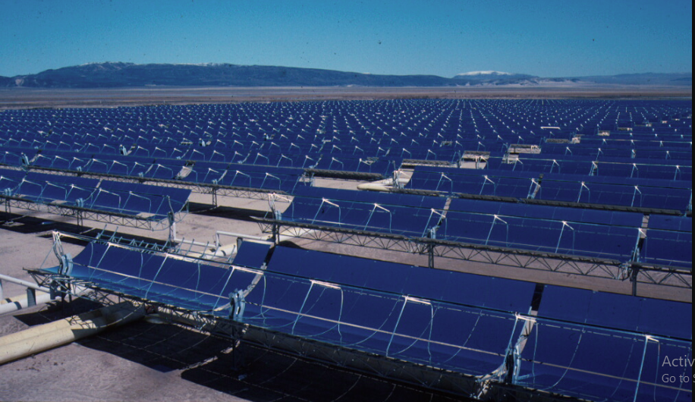
Part of the 354 MW SEGS solar complex in northern San Bernardino County, California

Slide 89
As the temperature increases, different forms of conversion become practical. Up to 600 °C, steam turbines, standard technology, have an efficiency up to 41%
Above 600 °C, gas turbines can be more efficient. Higher temperatures are problematic because different materials and techniques are needed
One proposal for very high temperatures is to use liquid fluoride salts operating between 700 °C to 800 °C, using multi-stage turbine systems to achieve 50% or more thermal efficiencies

Slide 90
The higher operating temperatures permit the plant to use higher-temperature dry heat exchangers for its thermal exhaust, reducing the plant's water use – critical in the deserts where large solar plants are practical
High temperatures also make heat storage more efficient, because more watt-hours are stored per unit of fluid

Slide 91
Solar Energy
The average incident solar energy received on earth’s surface is about 600 W/m² but the actual value varies considerably
Advantages are free of cost, non exhaustible and completely pollution free
Drawbacks are; energy density per unit area is very low, it is available only for a part of the day
Cloudy and hazy atmospheric conditions greatly reduce energy received
Utilizing solar energy for generation, challenging technological problems exist, the most important being that collection and concentration of solar energy and its conversion to the electrical from through efficient and with economic means

Slide 92
Wave Energy
The energy content of sea waves is very high
In long coast line countries, with several hundreds of kilometers of coastline, a vast source of energy is available
The power in the wave is proportional to the square of the amplitude and to the period of the motion
Therefore, the long period (~ 10 s), large amplitude (~ 2m) waves are of considerable interest for power generation, with energy fluxes commonly averaging between 50 and 70 kW/m width of on coming wave
Though the engineering problems associated with wave-power are formidable, the amount of energy that can be harnessed is large and development work is in progress

Slide 93
Wave Energy Phenomena
As the wind passes over the surface of the oceans, a portion of the winds kinetic energy is transferred to the water below, generating waves
In fact, the ocean could be viewed as a vast storage collector of energy transferred by the sun to the oceans, with the waves carrying the transferred kinetic energy across the surface of the oceans
The kinetic energy of the wave turns a turbine attached to a generator, which produces electricity
However, the open oceans can be a stormy and violent environment, resulting in the wave energy machines being destroyed by the energy they were designed to capture.

Slide 94
Physical phenomena
Waves are generated by wind passing over the surface of the sea
As long as the waves propagate slower than the wind speed just above the waves, there is an energy transfer from the wind to the waves
Both air pressure differences between the upwind and the side of a wave crest , as well as friction on the water surface by the wind, making the water to go into the shear stress causes the growth of the waves

Slide 95
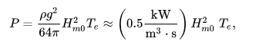
In deep water where the water depth is larger than half the wavelength, the wave energy flux is;

Slide 96
with P the wave energy flux per unit of wave-crest length, H_{m0} the significant wave height, T_{e} the wave energy period, ρ the water density and g the acceleration by gravity
The above formula states that wave power is proportional to the wave energy period and to the square of the wave height
When the significant wave height is given in metres, and the wave period in seconds, the result is the wave power in kilowatts (kW) per metre of wave front length

Slide 97
Example: Consider moderate ocean swells, in deep water, a few km off a coastline, with a wave height of 3 m and a wave energy period of 8 seconds
Using the formula to solve for power, we get;
In major storms, the largest waves offshore are about 15 meters high and have a period of about 15 seconds
According to the above formula, such waves carry about 1.7 MW of power across each metre of wavefront

Slide 98
Biofuels
The material of plants and animals is called biomass, which may be transformed by chemical and biological processes to produce intermediate biofuels such as methane gas, ethanol liquid or charcoal solid
Biomass is burnt to provide heat for cooking, comfort heat (space heat), crop drying, factory processes and raising steam for electricity production and transport
Renewable energy programs are specially designed to meet the growing energy needs in the rural areas for promoting decentralized and hybrid development so as to stem growing migration of rural population to urban are as in search of better living conditions
It would be through this integration of energy conservation efforts with renewable energy programs that any country would be able to achieve a smooth transition from fossil fuel economy to sustainable renewable energy based economy and bring "Energy for all" for reasonable and environmental friendly sustainable development

Slide 99
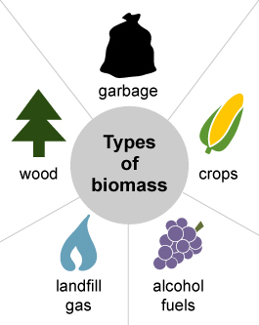
Biomass
Biomass is organic material that comes from plants and animals, and it is a renewable source of energy
Biomass contains stored energy from the sun
Plants absorb the sun's energy in a process called photosynthesis
When biomass is burned, the chemical energy in biomass is released as heat

Slide 100
Biomass
Growing crops of wood or other kinds of biomass to burn as fuel for generating electricity has some appeal as a means of utilizing the solar energy captured by photosynthesis for electrical power generation
The main advantages of biofuels are that they are renewable energy resources which ultimately do not contribute to global warming
Just as with fossil fuels however, burning biomass fuel to raise steam in conventional electricity generating plants also generates greenhouse gases
In the case of biomass however, the process of growing the new biomass is based on photosynthesis which uses energy captured from sunlight to extract CO₂ from the atmosphere and convert it into the combustible organic compounds thus offsetting the greenhouse gas generated by burning

Slide 101
Unfortunately the logistics often defeat the arguments for using biomass
The energy content of biomass is relatively low and vast areas of land are needed for cultivating the fuels and furthermore a lot of energy is required to harvest and move the crops to the power station

Slide 102
Parameters effecting Biofuels for energy generation
The energy content of biomass fuels, as harvested, is highly variable due to the variability of the moisture content of the fuel as well as the nature of the crop itself
Woods and grasses as harvested may have calorific values of only 10 GJ/tonne due their high moisture content, typically 50%, but the calorific value may be improved by drying the fuel
Natural air drying can reduce the moisture content to as low as 20% and oven drying to even lower levels enabling calorific values of 18 GJ/tonne or more to be achieved.

Slide 103
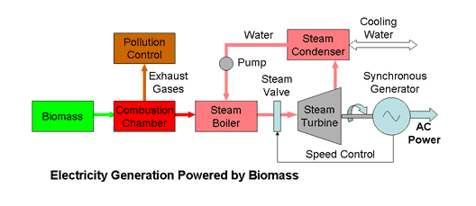
Electricity Generation Plant

Slide 104
Energy Storage
There is a lot problem in storing electricity in large quantities
Energy which can be converted into electricity can be stored in a number of ways
Storage of any nature is however very costly and its economics must be worked out properly
Various options available are: pumped storage, compressed air, heat, hydrogen gas, secondary batteries, fly wheels and superconducting coils

Slide 105
As already mentioned, gas turbines are normally used for meeting peak loads but are very expensive
A significant amount of storage capable of instantaneous use would be better way of meetings peak loads, and so far the most important way is to have a pumped storage plan
Secondary Batteries:
The most widely used storage battery is the lead acid battery
Sodium-sulphur battery (200 Wh/kg) and other combinations of materials are also being developed to get more output and storage per unit weight.

Slide 106
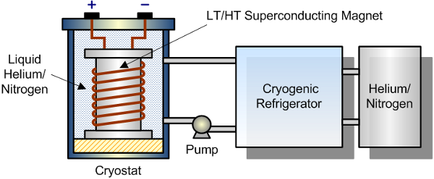
Super conductor

Slide 107
Superconducting Magnetic Energy Storage (SMES) systems store energy in the magnetic field created by the flow of direct current in a superconducting coil which has been cryogenically cooled to a temperature below its superconducting critical temperature
A typical SMES system includes three parts: superconducting coil, power conditioning system and cryogenically cooled refrigerator
Once the superconducting coil is charged, the current will not decay and the magnetic energy can be stored indefinitely.

Slide 108
The stored energy can be released back to the network by discharging the coil
The power conditioning system uses an inverter/rectifier to transform alternating current (AC) power to direct current or convert DC back to AC power
The inverter/rectifier accounts for about 2–3% energy loss in each direction
SMES loses the least amount of electricity in the energy storage process compared to other methods of storing energy
SMES systems are highly efficient; the round-trip efficiency is greater than 95%

Slide 109
Fuel Cells
A fuel cell converts chemical energy of a fuel into electricity directly, with no intermediate combustion cycle
In the fuel cell, hydrogen is supplied to the negative electrode and oxygen (or air) to the positive
Hydrogen and oxygen are combined to give water and electricity
The porous electrodes allow hydrogen ions to pass
The main reason why fuel cells are not in wide use is their cost (> $ 2000/kW)
Global electricity generating capacity from full cells will grow from just 75 Mw in 2001 to 15000 MW by 2010 USA
Germany and Japan may take lead for this…..

Slide 110
Hydrogen Energy System
Hydrogen can be used as a medium for energy transmission and storage
Electrolysis is a well-established commercial process yielding pure hydrogen
H₂ can be converted very efficiently back to electricity by means of fuel ceils
Also the use of hydrogen as fuel for aircraft and automobiles could encourage its large scale production, storage and distribution

Slide 111
System configuration
The system presented here includes a hydrogen production installation—via water electrolysis—using renewable energy sources, so as to use it in a fuel cell bus (FC)
Figure illustrates the system configuration
The renewable PV and wind power are taken as primary energy sources
It is noted that solar PV and wind systems cannot provide a continuous supply due to the fact that those systems will generate electricity only during sunny and windy days

Slide 112
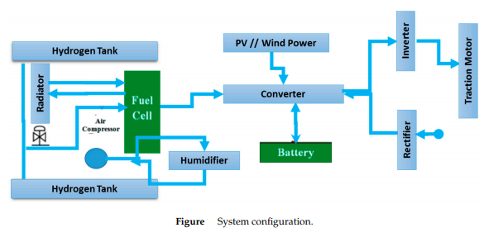

Slide 113
Hence, a combination of these two sources improves the overall energy output
A proper optimization is required to ensure having an optimal number and size of PV and Wind Turbine
All of the energy systems are connected in parallel to a common DC bus line through appropriate power electronic interfacing circuits
When there is an excess solar generation available, the electrolyser is activated to initiate the necessary hydrogen production for bus fueling, which is delivered to hydrogen storage tanks at low pressures

Slide 114
Solar and wind energy are converted to electricity via a PV non-tracking flat plate collector and a wind turbine
A bus fuel cell is made up, in general, of a fuel cell stack system, an air compressor system, a hydrogen supply system and an air refrigeration system
The fuel cell stack system generates the required power for the bus (Figure)
The air compression sub-system provides the essential oxygen, through air, to the fuel cells
The system contains two compressor stages, compression and hyper-compression, which are been driven by the air of evaporation of the fuel cell, an air to air exchanger, and the filters

Slide 115
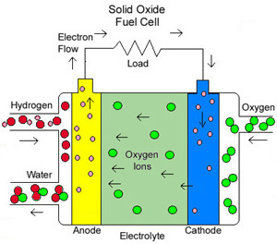
Fuel Cell

Slide 116
If free electrons or other substances could travel through the electrolyte, they would disrupt the chemical reaction
Whether they combine at anode or cathode, together hydrogen and oxygen form water, which drains from the cell
As long as a fuel cell is supplied with hydrogen and oxygen, it will generate electricity.

Slide 117
Next Lecture
Problems related to power generation using renewable resources (Lecture 3-a)
Distribution planning (Lecture 4)
Definitions and problems

Slide 118
Power System Planning
Lecture No.4
Prof. Dr. Muhammad Kamran
mkamran@uet.edu.pk

Slide 119
Lecture contents
Electric power distribution system
All concerned definitions and Problems

Slide 120
Connected Load
It is the sum of continuous ratings of the load consuming apparatus connected to the system
Demand factor DF is the ratio of the maximum demand of the system to the total connected load of the system, Therefore, the demand factor is ;
DF= Maximum demand/ Total connected load

Slide 121
Utilization Factor
It is the ratio of demand of a system to the rated capacity of system
Utilization factor is ;
Maximum demand/rated system capacity
The utilization factor can also be found for a part of the system
The rated system capacity may be selected to be the smaller of thermal or voltage drop capacity

Slide 122
Capacity Factor
A base load power plant with a capacity of 1,000 megawatts (MW) might produce 648,000 megawatt-hours (MW·h) in a 30-day month
The number of megawatt-hours that would have been produced had the plant been operating at full capacity can be determined by multiplying the plant's maximum capacity by the number of hours in the time period. 1,000 MW × 30 days × 24 hours/day is 720,000 MW·h
The capacity factor is determined by dividing the actual output with the maximum possible output. In this case, the capacity factor is 0.9

Slide 123
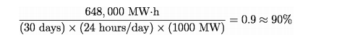

Slide 124
Plant Factor/ Capacity Factor
It is the ratio of the total actual energy produced or served over a designated that period of time to the energy that have been produced or served if the plant had operated continuously at maximum rating
It is also known as the capacity factor or the use factor
Therefore;

Slide 125
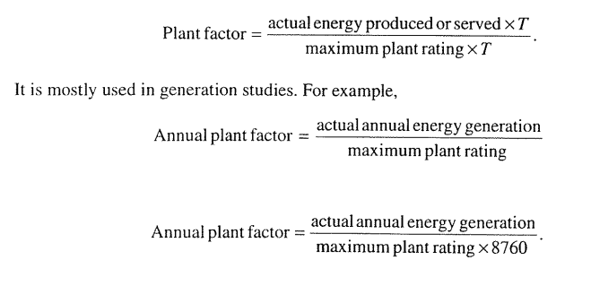

Slide 126
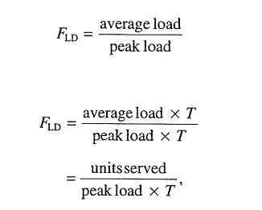
Load Factor is the ratio of the average load over a designated period of time to the peak load occurring on that period
Therefore, load factor F_{LD} is the ratio of the average load to peak load;

Slide 127
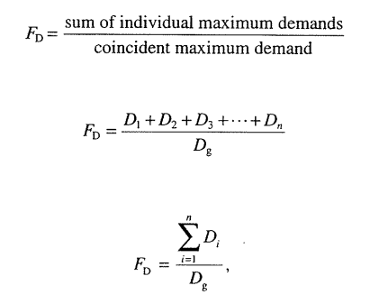
Where T is the time, in days, weeks, months or years
Annual Load Factor=Total annual energy/(annual peak loadX8760)
Diversity factor---is the ratio of the sum of the individual maximum demands of the various subdivisions of a system to the maximum demand of the whole system, therefore Diversity factor is;

Slide 128
Coincident Demand
Coincident peak demand is the energy demand by that group during periods of peak system demand.
Coincident peak demand is the energy demand by that group during periods of peak system demand
Loosely speaking, it refers to demand among a group of customers that coincides with total demand on the system at that time

Slide 129
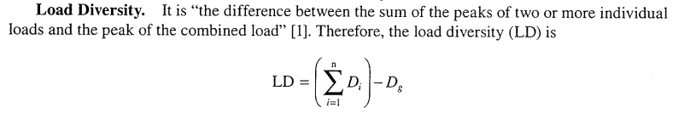

Slide 130
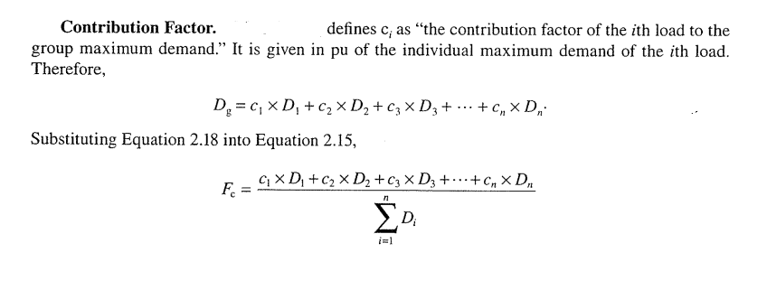
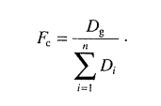

Slide 131
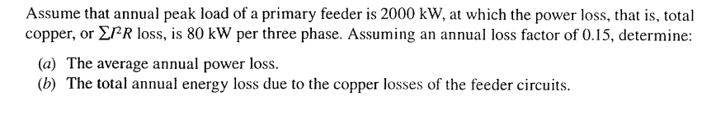
Non coincident Demand
The sum of demands of a group of loads with no restrictions on the interval demand is applicable

Slide 132
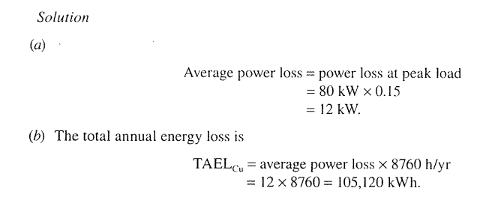
Solution

Slide 133
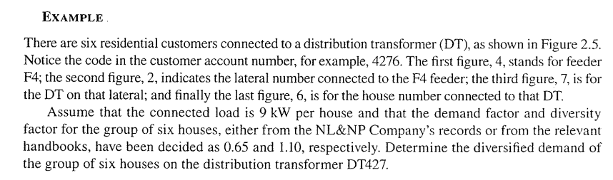
Problem

Slide 134
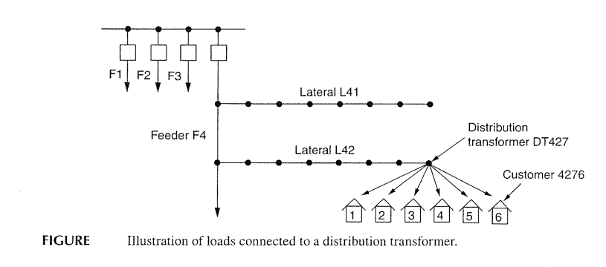

Slide 135
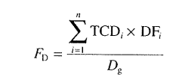
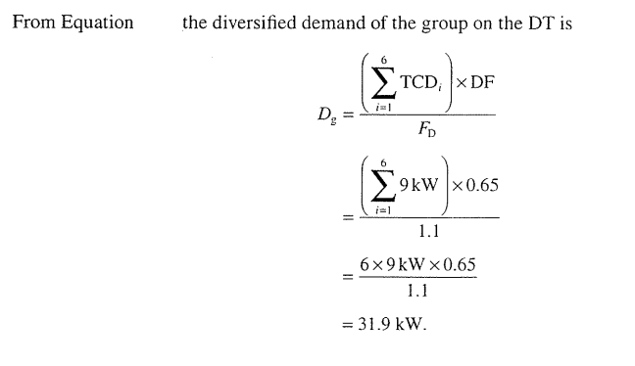
Solution
TCD=Total Connected Demand
DF= Demand Factor
Dg=Diversified demand

Slide 136
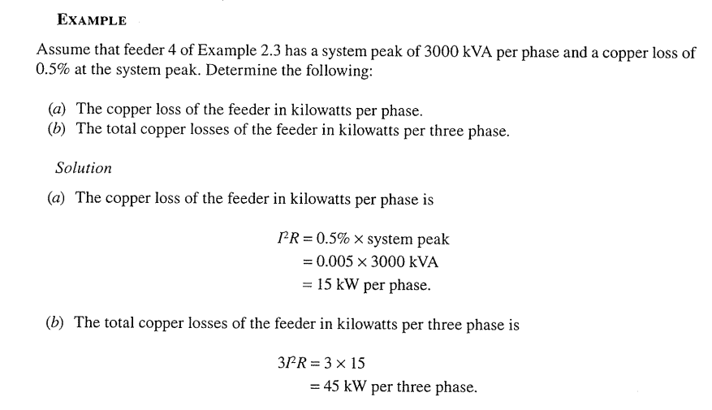

Slide 137
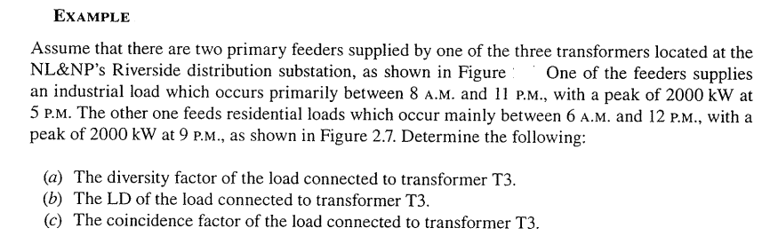

Slide 138
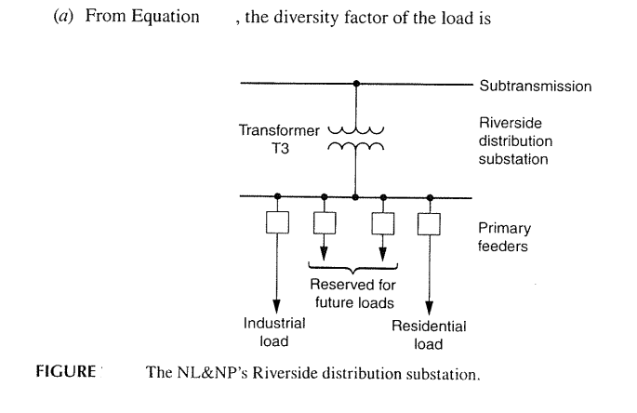
Problem

Slide 139
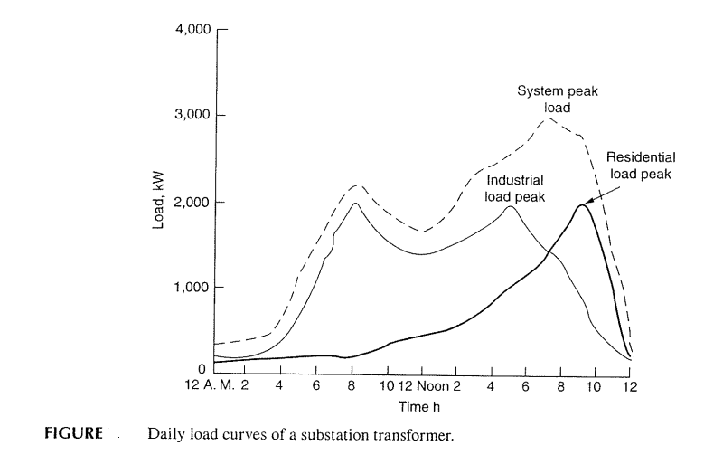
Fig. 2.7

Slide 140
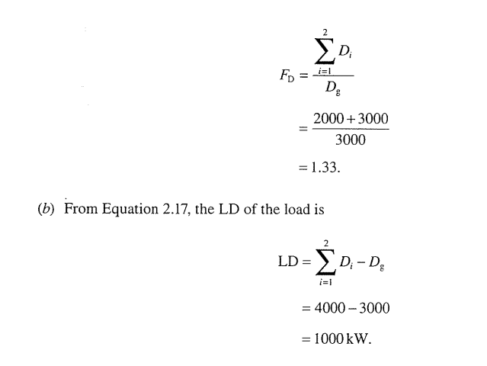
LD-Load Diversity
Fd= 2000+2000/3000

Slide 141
Coincidence factor; F_{c}= 1/F_{d}
F_{c}= 1/1.33=0.752;

Slide 142
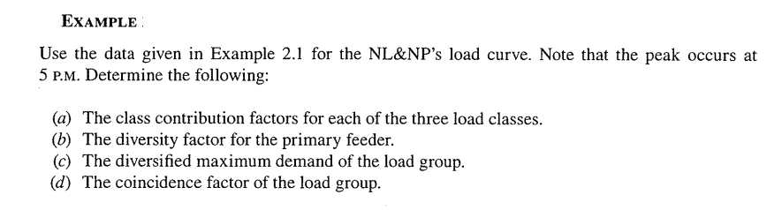

Slide 143
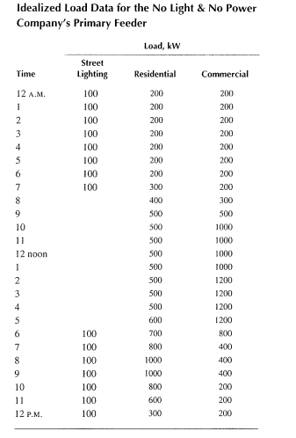

Slide 144
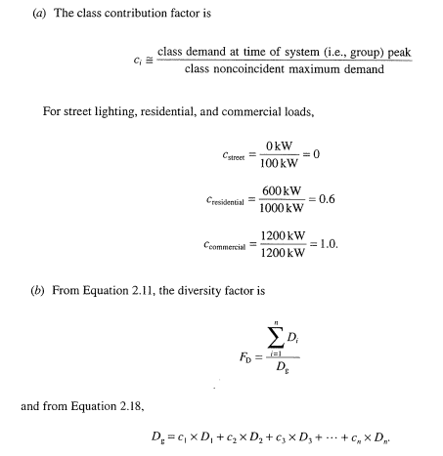

Slide 145
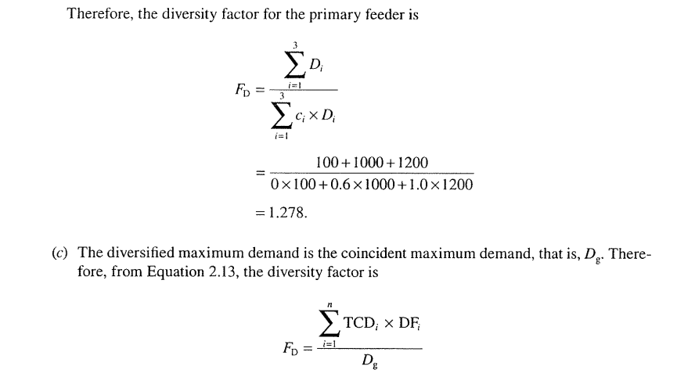

Slide 146
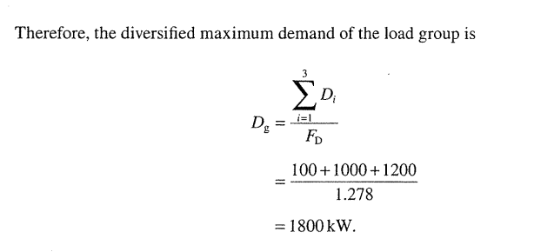
Maximum Demand=Total connected demand X DF
Fd = $\frac{\sum_{i=1}^{n}{TCDi X DFi}}{Dg}$
Maximum demand= total connected demand X DF
Dg = $\frac{\sum_{i=1}^{n}{TCDi X DFi}}{Fd}$

Slide 147


Slide 148
Relation between Load and Loss factor
In general, the loss factor cannot be determined from the load factor
Assume that primary feeder is connected to a variable load
Fig in next slide shows an arbitrary and idealized load curve
However, it does not represent a daily load curve
Assume off peak loss is P_{LS,1} at some off-peak load P₁ and that the peak loss is P_{LS,2} at the peak load P₂, the load factor is;
$FLD=\frac{Pavg}{Pmax}$=P_{avg}/P₂

Slide 149


Slide 150


Slide 151


Slide 152
The copper losses are the function of the associated loads
Therefore, the off peak and peak loads can be expressed, respectively, as;
P_{LS,1}=k X P₁²
P_{LS,2}=k X P₂²
Where k is constant
Substituting equations, F_{LS} will be;

Slide 153


Slide 154


Slide 155


Slide 156


Slide 157
Load-loss factor
Load-loss factor (LLF) is a factor which when multiplied by energy lost at time of peak and the number of load periods will give overall average energy lost
It is calculated as the ratio of the average load loss to the peak load loss

Slide 158
Why these calculations are important
Electric distribution utilities observe the considerable increase of the technical and nontechnical losses in their network
Thus utilities need to look for more accurate tools for loss calculation
In order to select the optimal solution for loss reduction, need to have loss estimation or calculation models

Slide 159
Example
Using a large commercial electrical bill:
peak demand = 436 kW
use = 57200 kWh
number of days in billing cycle = 30 d
Load factor = { 57200 kWh / (30 d × 24 hours per day × 436 kW) } × 100% = 18.22%

Slide 160


Slide 161


Slide 162


Slide 163

Example

Slide 164

Solution

Slide 165


Slide 166

Example

Slide 167

Solution

Slide 168


Slide 169


Slide 170

EXAMPLE

Slide 171


Slide 172
Example

Slide 177
Discussion will be continued…….

Slide 178
Power System Planning
Prof. Dr. Muhammad Kamran
Lecture No. 5
mkamran@uet.edu.pk

Slide 179
Contents
Maximum diversified Demand
Load Forecasting
Box-Jenkins Method
Small Area Load Forecasting
Spatial Load Forecasting
Problems

Slide 180
Maximum Diversified Load
Scientists developed a method of estimating Transformer load in residential areas by diversified demand method which takes into account the diversity between similar loads and non coincidence of peaks of different types of loads
It is the ratio of the demand of particular type of load coincident with the group maximum demand to maximum demand of that particular load

Slide 181
Coincident demand: The energy demand required by a given customer or class of customers during a particular time period.
Coincident peak demand: The energy demand by that group during periods of peak system demand
Customer’s coincident peak demand is usually calculated from meter readings taken at the time when the customer’s demand is likely to be highest
Non-coincident Peak Demand: Calculated using several readings taken at different times to determine what their actual peak demand periods may be Customer or class of customers during a particular time period

Slide 182
An energy provider may care more about demand at a given time when total customer demand is highest than they care about the peak demand of a given customer during other times

Slide 183
Example
Graphs are drawn for various types of household appliances to determine the average maximum diversified demand per customer in KW/load
To determine maximum diversified demand for a given saturation and appliance, the following steps are suggested;
Determine total number of appliances
Read the corresponding diversified demand per customer from curve for the given number of appliances
Determine maximum demand, multiplying the demand found above by the total number of appliances
Finally determine the contribution of that type of load by multiplying resultant by corresponding hourly variation factor found from table

Slide 184


Slide 185


Slide 186


Slide 187

Solution

Slide 188


Slide 189


Slide 190


Slide 191


Slide 192
Load Forecasting (1)
The load growth of the geographical area served by a utility company is the most important factor influencing the expansion of the distribution system
Therefore, forecasting of load increases is essential to the planning process
Fitting trends after transformation of data is a common practice in technical forecasting
An arithmetic straight line that will not fit the original data may fit, for example, the logarithms of the data typified by the exponential trend $yt$=a x^{b}

Slide 193
The expression is called growth equation, since it is used to describe phenomena of growth through time
If load growth rate is known then the load at the end of nth year is given by $Pn=P0\left(1+g\right)n$
P_{n} is the load at the nth year, Po is initial load and g is the annual growth rate
If we set P_{n} as yt, Po=a and 1+g= X and n=b
Equation shows exponential trend giving load forecasting if initial load is given as $yt$=a x^{b}

Slide 194

Forecast by Historical Trends (2)

Slide 195
Forecast by location (3)
Methods that forecast future demand by location divide the utility service area into set of small areas forecasting the load growth in each
Most modern small area forecast method work with uniform grid of small areas cover the utility service area
Regardless of how small areas are defined, most forecasting methods themselves invariably fall into two categories, trending and land use
Trending extrapolate past historical peak loads using curve fitting or some other method

Slide 196
On the contrary, the behavior of land growth in any relatively small area is not smooth curve but “S” curve which includes distinct phases like dormant, growth and saturation phases
In order to plan a T&D system, it is necessary to study not just overall load in a region but to study and forecast load on SPATIAL BASIS, i.e., analyzing it in a total and on a local area basis throughout the system determining “where” and “How much” load growth is expected for determining transmission and distribution expansion
Regression is the study of the behavior of a time series or a process in the past and its mathematical modeling so that future behavior is extrapolated

Slide 197
Fitting of continuous mathematical functions through actual data to achieve the least overall error is known as regression analysis
The second approach is more widespread in short term forecasting
A time varying event such as distribution system load can be broken down into following four major components;
1- Basic trend
2- Seasonal variation that is monthly and yearly
3- Cyclic variation which includes influences of periods longer than above and causes the load pattern to be repeated for 2-3 years or even longer

Slide 198
4- Random variations which occur on account of the day to day changes and in the case of power systems are usually dependent on weather and the time of week, for example week day and weekend and so on
The principle of regression theory is that any function y = f(x) can be fitted to a set of points (x₁,y₁), (x₂,y₂) so as to minimize the sum of errors squared to each point, that is
$ɛ2=\sum_{i=1}^{n}{\left(yi−f(x))2\right)}$= Minimum

Slide 199


Slide 200
Other techniques are Least square Parabola, least square exponential, Multiple regression

Slide 201
BOX-JENKINS METHOD
This method uses a stochastic time series to forecast future load demands
It is popular method for short term forecasting
Box and Jenkins developed a method of forecasting by trying to account for repeated movements in the historical series, leaving a series made up of only random that is irregular movement
To model the systematic patterns inherent in this series and upon differencing to account for seasonal and earthly movements

Slide 202
The Box Jenkins methodology is an iterative procedure by which a stochastic model is constructed
The process starts with the most simple structure with least number of parameters and develops into as complex structure as necessary to obtain an adequate model

Slide 203
Small Area load forecasting
In this forecasting, the utility services area is divided into a set of small areas and the future load growth in each area is forecasted
Most modern area forecast methods work with a uniform grid of small area that covers the utility service area , but more traditional approach was to forecast growth on a substation by substation or feeder by feeder basis
A small area is not smooth which is intense for several years then drops to very low level while high growth begins in other areas which is in Gompertz or “S” curve

Slide 204

Gompertz Curve

Slide 205
It is a type of mathematical model for a time series, where growth is slowest at the start and end of a time period.
Examples of uses for Gompertz curves include:
Mobile phone uptake, where costs were initially high (so uptake was slow), followed by a period of rapid growth, followed by a slowing of uptake as saturation was reached
Population growth in a confined space first increase and then slow as resource limits are reached.
Modeling of growth of tumors

Slide 206
Spatial Load Forecasting
In general small area load growth is spatial.
The majority of load growth effects in any small area are due to effects from other small areas, some are far away and a function of distances from those areas
Therefore, the forecast of any one area must be based on an assessment data not only for that area but also for neighboring areas
The best available trending method in terms of tested accuracy is load trend coupled (LTC) extrapolation using modified form of Markov regression in which computation for load extrapolation has been considerably reduced

Slide 207
Load Management
Load management process involves controlling system loads by remote control of individual customer loads
Such control includes suppressing or biasing automatic control of cycling loads as well as load switching
Load management can also be affected by inducing customers to suppress loads during utility selected daily periods by means of time of day rate incentives
Such activities are called demand side management (DSM)
Demand side management includes all measures, programs, equipment and activities that are directed towards improving efficiency and cost effectiveness of energy usage on the customer side

Slide 208
In general, such load control results in a load reduction at time “t” that is ΔS(t) which can be expressed as;
ΔS(t)= S_{avg} X [D_{uncont} (t) – D_{cont} (t)] X N
Where S_{avg} is the average connected load of controlled devices, D_{uncont}(t) is the duty cycle allowed by the load control at time t, and N is number of units under control
Distribution automation provides the control and monitoring ability required for both load management scenarios
It provides for direct control of customer loads, and the monitoring necessary to verify that programmed levels are achieved

Slide 209


Slide 210


Slide 211
Thus overall total reduction is;
75 MW +6 MW= 81 MW

Slide 212
Fuel cost Adjustment
Calculated monthly bill rate may be increased or decreased for each KWh consumed by an amount calculated as per given formula;
FCAF= A X B X 10⁻⁶ X C X (1/1-D)
FCAF is fuel cost adjustment factor, $/KWh, to be applied on each KWh consumed
A- weighted average BTU per KWh for net generation from thermal plants
B- Amount by which average cost of fuel per million BTU is billed
C- Ratio in decimal , of total net generation from thermal plants to total net generation from all plants including hydrogenation
D- Loss factor, ratio of KW-Hour losses to net system input

Slide 213


Slide 214


Slide 215

Solution

Slide 216


Slide 217


Slide 218


Slide 219


Slide 220


Slide 221

Pay Back period will be 8 months…$69/$9.2/Month
Discussion will be continued

Slide 222
Power System Planning
Lecturer 6
Prof. Dr. Muhammad Kamran
mkamran@uet.edu.pk

Slide 223
Contents
Transformers for Overhead and under ground system
Transformer voltage regulation, losses ad efficiency
Connections
Problems

Slide 224
Types of Transformers
Heat is limiting factor in transformer loading
Removing the coil heat is an important task
In liquid filled types, transformer coils are immersed in smooth surfaced, oil filled tank
Oil absorbs the coil heat and transfers it to the tank surface which, in turn, delivers it to the surrounding air
For transformers 25kVA and larger, the size of smooth tank surface required to dissipate heat becomes larger than that required to enclose the coils

Slide 225
Therefore, the transformer tank may be corrugated to add surface, or external tubes may be welded to the tank
To further increase the heat disposal capacity, air may be blown over the tube surface
Such designs are known as forced air cooled transformers
Distribution transformers can be classified as (i) Dry Type and (ii) liquid filled type
Dry type distribution transformer either air cooled or air insulated
Liquid filled type distribution transformer can be oil filled and inerteen polychlorinated biphenyl (insulation material) filled

Slide 226
Over head system Distribution transformer
Conventional transformer
Completely self protecting transformers

Slide 227


Slide 228


Slide 229
Completely Self Protected transformers contain several safeguards to avoid issues that would cause overloading or damage to the transformer
Conventional transformers do not have any of these features which usually means they will need to be attached to a cut out switch
The most recognizable component of a CSP transformer is the lightning arrestor
The arrestor protects against power surges caused by switching, lightning, or other high voltage sources.

Slide 230
Another component CSP transformers are fitted with is the current sensing weak link on the high voltage side
If any part of the power distribution system fails, and too much current is being drawn, this weak link will open
It provides an internal fusing as a last result to limit the transformer windings from being damaged from overdrawn currents
The last protective device on a standard CSP transformer is the low voltage breaker
This device typically has several different functions.

Slide 231
A handle is attached to allow the breaker to be manually placed in an open or closed position
The breaker will also have a float which prevents operation under low oil conditions.

Slide 232
Pad mounted distribution transformer (Specs)
These specifications cover the electrical and mechanical features of a three phase, 60 hertz, liquid-filled , self-cooled, pad-mounted compartmentalized transformer
Transformers covered by this specification shall be the standard KVA ratings of 75, 150, 300, and 750 with the high voltage windings having a basic lightning impulse insulation level (BIL) of 95KV
For three-phase transformers, the high voltage winding shall be closed DELTA and rated for 12,000 Volts line-to-line with the secondary winding configured Grounded-WYE and voltage rating of either 480/277V, 240/120V, or 208/120V

Slide 233
Transformer Temperatures
Transformers supplied shall have an average winding temperature rating of 65/75°C
The average winding temperature and oil temperature near the top of the transformer tank shall not exceed 65°C when loaded at base kVA rating
Additionally, under continuous operations at the transformer’s rated kVA, no hot-spot windings shall exceed a 90°C rise over ambient
The transformer shall provide an additional 12% capacity at the 75°C rating

Slide 234
Transformer percent impedance values shall not be less than the following: -
75 kVA 2.7% -
150 kVA 3.1% -
300 kVA 3.1% -
750 kVA 4.4%

Slide 235
Protection equipment
Each transformer shall be supplied with one oil-immersed partial range current limiting fuse(s) per phase
The current limiting fuse manufacturer and catalog information shall be identified on the transformer nameplate
The bayonet fuses shall be installed in series with current limiting fuses, inserted between the transformer winding and the high voltage bushing
These bayonet fuses shall be installed in series with the current limiting fuses, inserted between the transformer winding and the high voltage bushing

Slide 236

Bayonet fuse
Bay-O-Net assemblies to protect distribution apparatus from damaging currents and to protect distribution systems

Slide 237


Slide 238
The distribution transformers employed for underground distribution systems can be categorized as;
Subway transformers, Low cost residential transformers and network transformers
Subway transformers are used in underground vaults
They can be conventional type or current protected type
Low cost residential transformers are same as conventional type employed on overhead system

Slide 239
Network transformers are typically used to supply power to grid-type secondary distribution systems in areas of high load density such as found in large cities and are designed for either vault-type or subway-type applications
Vault-type network transformers are designed for installation in above-ground dry vaults
Subway-type network transformers are designed for installation normally in subsurface vaults
Subway designs may also be used in vault-type applications.

Slide 240
Network transformers are employed in secondary networks
They have primary disconnecting and grounding switch and network protector mounted integrally on transformer
They can be either liquid filled, ventilated dry type or sealed dry type
Parameters regarding transformer performances are given in next slides;

Slide 241

Voltage Regulation

Slide 242


Regulation

Slide 243

Calculation

Slide 244

Example

Slide 245

Example 2

Slide 246


Slide 247


Transformer Efficiency
Efficiency is maximum when iron losses are equal to copper loss

Slide 248
Iron losses include (i) Hysteresis loss and (ii) Eddy current loss
The hysteresis loss is due to power requirements maintaining the continuous reversals of elementary magnets
The eddy current loss is due to circulating current in the iron core caused by varying fluxes in the iron
Eddy current loss is proportional to square of frequency and square of flux density

Slide 249


Slide 250
total hysteresis losses = Total area inside hysteresis loop*volume of core
According to Steinmetz’s formula, the heat energy dissipated due to hysteresis is given by
W_{h}=ηβ_{max}^{1.6} , and,
Hysteresis loss is thus given by
P_{h}≈ W_{h}f ≈ηfβ_{max}^{1.6}
Where, f is the frequency, η is the hysteresis coefficient and βmax is the maximum flux density, the empirical exponent of which varies from about 1.4 to 1 .8 depending on the material used for core but is often given as 1.6 for iron.

Slide 251
Problem
The load schedule for a 24-hr period on a 30-kva, 2400/240 v, 60-cycle transformer is as follows
Hours Kw PF
10 2.5 0.75
8 12.5 0.80
3 20.0 0.85
3 25.0 0.90
The data taken from open-circuit and short-circuit tests follow
High side open, measurements on low-voltage side
240 Volts
2.45 Amperes
154 Watts

Slide 252
Side short circuited, measurements on high side;
61.1 Volts
12.5 Amperes
706 Watts
Determine the energy efficiency for a daily load cycle?

Slide 253
Solution
The core losses are constant for the 24-hr period, and the energy dissipated in core loss is therefore
(154 x 24)/1000 = 3.70 kwhr
The load losses are proportional to the square of the current, i.e., to the square of the kva load
Energy dissipated in the load loss are computed in the following table;

Slide 254


Slide 255

The load loss is proportional to the square of the kva load; hence, at 3.33 kva, the load loss is;
(3.33/30)² X 706= 8.71 Watts

Slide 256
Equivalent circuit of transformer
Fig in next slide is an equivalent circuit of a single phase two winding transformer
It represents a practical transformer with an iron core and connected to load (L)
When primary winding is excited, flux is produced in iron core
The flux that links both primary and secondary is called the mutual flux and its maximum value is denoted by φm
There are leakage fluxes φl1 and φl2 at primary and secondary winding

Slide 257


Slide 258
Xl₁ and Xl₂ are primary and secondary inductive reactance
r₁ and r₂ are primary and secondary resistances
Equivalent circuit of Loaded transformer
I₂’ current is a primary current or load component which exactly corresponds to secondary current I₂ as for ideal transformer,
I₂’ = n₂/n₁ X I₂
I₂ = I₂’/n
I_{e} is excitation current component of I₁ that is needed to produce the resultant mutual flux

Slide 259
I_{e} has two components , I_{m} is magnetizing current and Ic core loss current
R_{c} represents resistance of the equivalent transformer causing power loss due to (hysteresis and eddy current) iron losses of transformer
X_{m} is reactance due to magnetization current

Slide 260


Slide 261

Single phase transformer Connections

Slide 262
Single Phase Transformer Paralleling
When greater capacity is required in emergency situations, two single phase transformers of the same or different KVA ratings can be connected in parallel
The single phase transformers can be either additive or subtractive polarity as long as the following conditions are observed and connected;
1- All transformers have the same turns ratio
2- All transformers are connected to the same primary phase
3- All transformers have identical frequency

Slide 263
4- All transformers have identical voltage rating
5- All transformers have identical tap setting
The various combinations of single phase transformer paralleling is given in next slide;

Slide 264


Slide 265
Auto Transformer
The usual transformer has two windings which are not connected to each other, whereas an autotransformer is a transformer in which one winding is connected in series with the other as single winding
It is like normal transformer connected in a special way
It is rated on the basis of output KVA
It has lower leakage reactance, lower losses, smaller excitation current requirements and cheaper than two winding transformer

Slide 266


Slide 267


Slide 268


Slide 269


Slide 270
Next Lecture
Discussion will be on substations after problems

Slide 271
Power System Planning
Prof. Dr. Muhammad Kamran
Lecture No. 7
mkamran@uet.edu.pk

Slide 272
Contents
Design of sub Transmission lines for given area
Types of Distribution substations

Slide 273
Introduction (Chap-4)
In broad definition, the distribution system is that part of the electric system between the bulk power source and customers service switches
The definition of the distribution system includes the following components;
1- Sub transmission system
2- Distribution substation
3- Distribution or primary feeders
4- Distribution transformers
5- secondary circuits
6- Service drops

Slide 274
Sub transmission
Sub transmission system is that part of electric utility system which delivers power from bulk power sources such as large transmission substations
The sub transmission circuits may be made of overhead open wire construction on wood or steel poles or of underground cables
Voltage of these circuits varies from 12.7 to 245 kV with majority at 69, 115 and 138 kV
There is continuous trend in usage of higher voltages as a result of increasing use of higher primary voltages

Slide 275
The sub transmission system designs varies from simple radial system to sub transmission network
The major consideration affecting the design are cost and reliability
In Radial system circuit radiates from the bulk power stations to the distribution substations
It is simple and has low first cost but has low service continuity
Instead an improved radial type sub transmission design is preferred
It allows faster service restoration in case of fault occurrence

Slide 276

Distribution substations
Distribution substation design has been somewhat standardized by the electric utility industry based on past experiences
standardization is a continuous process

Slide 277
Design aspects
The First Step in designing a Substation is to design an Earthing and Bonding System
The function of an earthing and bonding system is to provide an earthing system connection to which transformer neutrals or earthing impedances may be connected in order to pass the maximum fault current
The earthing system also ensures that no thermal or mechanical damage occurs on the equipment within the substation, thereby resulting in safety to operation and maintenance personnel.

Slide 278
In designing the substation, three voltages have to be considered.
1. Touch Voltage: This is the difference in potential between the surface potential and the potential at an earthed equipment whilst a man is standing and touching the earthed structure
2. Step Voltage: This is the potential difference developed when a man bridges a distance of 1m with his feet while not touching any other earthed equipment
3. Mesh Voltage: This is the maximum touch voltage that is developed in the mesh of the earthing grid

Slide 279
Earthing Materials
1. Conductors: Bare copper conductor is usually used for the substation earthing grid
The copper bars themselves usually have a cross-sectional area of 95 square millimetres, and they are laid at a shallow depth of 0.25-0.5m, in 3-7m squares
In addition to the buried potential earth grid, a separate above ground earthing ring is usually provided, to which all metallic substation plant is bonded
2. Connections: Connections to the grid and other earthing joints should not be soldered because the heat generated during fault conditions could cause a soldered joint to fail
Joints are usually bolted, and in this case, the face of the joints should be tinned

Slide 280
3. Earthing Rods: The earthing grid must be supplemented by earthing rods to assist in the dissipation of earth fault currents and further reduce the overall substation earthing resistance
These rods are usually made of solid copper, or copper clad steel.
4. Switchyard Fence Earthing: The switchyard fence earthing practices are possible and are used by different utilities. These are:
(i) Extend the substation earth grid 0.5m-1.5m beyond the fence perimeter
The fence is then bonded to the grid at regular intervals. (ii) Place the fence beyond the perimeter of the switchyard earthing grid and bond the fence to its own earthing rod system
This earthing rod system is not coupled to the main substation earthing grid.

Slide 281

Substation cost

Slide 282


Slide 283

Example

Slide 284


Slide 285

Substation Bus schemes

Slide 286


Slide 287


Slide 288
This is an alternative of a double bus system
The main conception of Main and Transfer Bus System is, here every feeder line is directly connected through an isolator to a second bus called transfer bus
The said isolator in between transfer bus and feeder line is generally called bypass isolator.
The main bus is as usual connected to each feeder through a bay consists of the circuit breaker and associated isolators at both sides of the breaker
There is one bus coupler bay which couples transfer bus and main bus through a circuit breaker and associated isolators at both sides of the breaker.

Slide 289
If necessary, the transfer bus can be energized by main bus power by closing the transfer bus coupler isolators and then breaker
Then the power in transfer bus can directly be fed to the feeder line by closing the bypass isolator
If the main circuit breaker associated with the feeder is switched off or isolated from the system, the feeder can still be fed in this way by transferring it to transfer bus

Slide 290


Slide 291


Slide 292
The schematic diagram of the system is given in the figure
It provides a double feed to each feeder circuit, opening one breaker under maintenance or otherwise does not affect supply to any feeder
But this system has two major disadvantages
One as it is a closed circuit system it is next to impossible to extend in future and hence it is unsuitable for developing systems
Secondly, during maintenance or any other reason, if any one of the circuit breaker in ring loop is switched off, the reliability of system becomes very poor as because closed loop becomes opened

Slide 293


Slide 294
Breaker and Half scheme
This is an improvement on the double breaker scheme to effect saving in the number of circuit breakers
For every two circuits, only one spare breaker is provided. The protection is however complicated since it must associate the central breaker with the feeder whose own breaker is taken out for maintenance
As shown in the figure that it is a simple design, two feeders are fed from two different buses through their associated breakers, and these two feeders are coupled by a third breaker which is called tiebreaker

Slide 295
Normally all the three breakers are closed, and power is fed to both the circuits from two buses which are operated in parallel
The tiebreaker acts as a coupler for the two feeder circuits
During the failure of any feeder breaker, the power is fed through the breaker of the second feeder and tiebreaker, therefore each feeder breaker has to be rated to feed both the feeders, coupled by the tiebreaker

Slide 296
Advantages of One and A Half Breaker Bus System
During any fault on any one of the buses, that faulty bus will be cleared instantly without interrupting any feeders in the system since all feeders will continue to feed from other healthy bus.
Disadvantages of One and a Half Breaker Bus System
This scheme is much expensive due to investment for third breaker.

Slide 297
Substation components
Circuit Breakers
Current Transformers
Isolators
Power Transformers
The following clearances should be observed
VOLTAGE LEVEL | MINIMUM GROUND CLEARANCE
less than 66kV | 6.1m
66kV - 110kV | 6.4m
110kV - 165kV | 6.7m
greater than 165kV | 7.0m
:

Slide 298

Substation location

Slide 299


Slide 300
Rating of Distribution substation
The additional capacity requirements of a system with increasing load density can be met by;
1- Either holding the service area of a given substation constant and increasing its capacity
2- or developing new substation and thereby holding the rating of the given substation constant
It is helpful to assume that the system changes (i) at constant load density for short term distribution planning and (ii) at increasing load density for long term planning

Slide 301
Analysis of Substation
Substation is analyzed as square shape scenario representing a part of service area or full service area
Assume square area is served by four primary feeders from central feeder point
Each feeder and its laterals are of three phase Dots represent balanced three phase loads lumped at that location and fed by distribution transformers

Slide 302


Slide 303
Percentage voltage drop from the feed point “a” to the end of last lateral at “C” is ;
Vd_{ac} = Vd_{ab} + Vd_{bc}
A simplified voltage drop calculation is made introducing constant K which can be defined as percent voltage drop per Kilo volt ampere-mile
Fig gives K-constant for various voltages and copper conductor sizes
Same fig is developed for three phase overhead lines with an equivalent spacing of 37 inches between phase conductor

Slide 304

K- constant for copper conductor, with load power factor 0.9

Slide 305
The following analysis is based on the work done by researchers and each feeder serves a total load of;
S₄= A₄ X D kVA from previous diagram, where S₄ is kilovoltampere load served by one of four feeders emanating from a feed point, A₄ is the area served by one of four feeders emanating from a feed point in (mi²) and D is load density-kVA/ mi²

Slide 306


Slide 307
It is assumed that the total or lumped sum load is located at a point on the main feeder at a distance of 2/3 x l4 from the feeder point a
Researcher extends the discussion to hexagonally shaped service area supplied by six feeders from the feed point which is located at the center as shown in fig assuming that each service area is equal to one –sixth of the hexagonal shaped total area or in next slide

Slide 308


Slide 309


Slide 310


Slide 311

Comparison of the Four and Six feeder Patterns

Slide 312



Slide 313


Slide 314


Slide 315

For Thermally Limited feeders
For given conductor size and neglecting voltage drop, I4=I6;

Slide 316


Slide 317
For voltage drop limited feeder circuits
Assuming same voltage drop % VD₄= %VD₆
%Vd₄=2/3 K.D.I₄^{3,} %Vd₆=2/3 / 1.73 K.D.I₆³
^{Equating Vd}₄ ^{and Vd}₆
l₄= 0.833 I₆
TA₆= 6/sqrt (3) X l₆²
Since TA₄= 4 x I₄²
TA₄ = 4x (0.833)²l₆²
=2.78 l₆²

Slide 318


Slide 319

Derivation of K Constant

Slide 320


Slide 321


Slide 322


Slide 323


Slide 324


Slide 325


Slide 326


Slide 327


Slide 328


Slide 329


Slide 330

Example

Slide 331


Slide 332

Example

Slide 333


Slide 334


Slide 335


Slide 336


Slide 337


Slide 338


Slide 339


Percent voltage drop formula interpretation

Slide 340


Slide 341


Slide 342



Slide 343

Example

Slide 344

Solution
Let From specs and size of conductor, max current = 230 amp

Slide 345


Slide 346


Slide 347


Slide 348

Substation size
Max load /feeder= Sn= D X l₄²
= 4 X 750 = 3000 kVA

Slide 349
Next Lecture
Calculations and SCADA

Slide 350
Power System Planning
Prof. Dr. Muhammad Kamran
Lecture-8
mkamran@uet.edu.pk

Slide 351
Lecture Contents
Examples with different configurations
IED
SCADA

Slide 352
Example
A square shaped distribution substation service are as shown in fig. Square area is 4 mi² numerous three phase laterals. Load is uniformly distributed with load density 2000 kVA/mi². Demand factor is 0.6 and diversity factor is 1.2 with p.f 0.9 lagging. Available substation sites are located at A and B. If designer selects site A as substation location with 2 mi long main and 16 3-phase 2 mi long literals.
If site B is selected there will be 3 mi long feeder with 32 three phase 1 mile long lateral. Which site will be better? If system is 7.62/13.2 kV, 3-phase, 4 wire, grounded Y primary feeder which are made of #2/0 copper over head conductors. Laterals are made #4 copper conductors and are all 3-phase, four wire and grounded Y. Which site is better with respect to voltage drops.

Slide 353


Slide 354


Slide 355


Slide 356
SCADA
Supervisory Control and Data Acquisition or simply SCADA is one of the solutions available for data acquisition, monitor and control systems covering large geographical areas
It refers to the combination of data acquisition and telemetry.
SCADA systems are mainly used for the implementation of monitoring and control system of an equipment or a plant in several industries like power plants, oil and gas refining, water and waste control, telecommunications, etc.

Slide 357

Automated Meter Reading AMR, Remote terminal unit RTU

Slide 358
Feeder control using SCADA
In this system, SCADA architecture continuously checks the faults and their location by using wireless fault detector units deployed at various feeding stations
In addition, it facilitates the remote circuit switching and historical data collection of feeder parameters and their status
The figure below illustrates feeder automation using SCADA.

Slide 359


Slide 360
In the above typical SCADA network, different feeders (underground as well as overhead networks) are automated with modular and integrated devices in order to decrease the number and duration of outages
Underground and overhead fault detection devices provide accurate information about transient and permanent faults so that at the remote side preventive and corrective measures can be performed in order to reduce the fault repeatability.

Slide 361
Ring main units and Remote Control Units (RTUs) of underground and overhead network responsible for maintenance and operational duties such as remote load switching, capacitor bank insertion and voltage regulation
The entire network is connected with a communication medium in order to facilitate remote energy management at the central monitoring station

Slide 362
Advantages of SCADA
Due to timely recognition of faults, equipment damage can be avoided
Continuous monitoring and control of distribution network is performed from remote locations
Saves labor cost by eliminating manual operation of distribution equipment
Reduce the outage time by a system-wide monitoring and generating alarms so as to address problems quickly
Improves the continuity of service by restoring service after the occurrence of faults (temporary)
Automatically improves the voltage profile by power factor correction and VAR control
Facilitates the view of historian data in various ways
Reduces the labor cost by reducing the staff required for meter reading

Slide 363
Now a days in modern countries all routine substation functions are remotely controlled.
A complete SCADA system can perform the following substation functions:
1- Automatic bus sectioning
2- Automatic reclosing after fault
3- synchronous check
4- Protection of equipment in substation
5- Fault reporting

Slide 364
6- Transformer load balancing
7- Voltage and reactive power control
8- Equipment condition monitoring
9- Data acquisition
10- status monitoring
11- data logging

Slide 365


Slide 366


Slide 367
All SCADA systems have two way data and voice communication between master and the remote stations
Modems at the sending and receiving ends modulate, for example, put information on the carrier frequency and demodulate that is to remove information from the carrier
Error detection codes are used to ensure correct data to be received and delivered
Remote terminal unit RTU properly codes remote station information into the proper digital form for the modem to transmit, and to convert the signals received from the master into the proper form for each piece of remote equipment

Slide 368


Slide 369
Advanced SCADA concepts
The increasing competitive business environment of utilities, due to deregulation, is causing a re examination of SCADA as a part of the process of utility operations
In advanced SCADA, WAN, work station based applications, have been incorporated which has provided access to substation controllers, automated mapping/ facility management system, crew dispatching and demand side load management
Unlike centralized data base management system, the advanced contains instant replacement of any interconnected element

Slide 370
In most applications today, SCADA and energy management system (EMS) operate only on the transmission and generation sides of system
Work is still going on economic dispatch algorithms which efficiently include demand side load management and voltage control solution

Slide 371


Slide 372


Slide 373


Slide 374


Slide 375
Planner’s considerations
Reduction of substation design and construction costs
Reduction of substation operating costs
Overall lowering of power system operating costs
Development of information for non SCADA functions
Utilization of existing resources and company standard for hardware, software and data base generation
Expansion of automated operations at the sub transmission and distribution levels
Improved customer relations

Slide 376
Developments in Integrated substation Automation
As a substation integration and automation technology is fairly new, there are no industry standard definitions with the exception of the following definitions
Intelligent Electronic Device (IED): Any device incorporating one or more processors with the capability to receive or send data/control from or to an external source, for example, digital relays, controllers, electronic multifunction meters
IED integration: integration of protection, control and data acquisition functions into a minimal number of platforms to reduce capital and operating costs, reduce panel and control room space and eliminate redundant equipment and databases

Slide 377
Substation Automation: Deployment of substation and feeder operating functions and applications ranging from SCADA and alarm volt/VAR control in order to optimize the management of capital assets and enhance operation and maintenance efficiencies with minimal human intervention
Open System: A computer system that embodies supplier independent standards so that software can be applied on many different platforms and can interoperate with other applications on local and remote systems

Slide 378

IED (Intelligent Electronic Devices)

Slide 379


Slide 380

Substation Grounding

Slide 381


Slide 382


Slide 383


Slide 384


Slide 385


Slide 386


Slide 387


Slide 388

Substation Grounding

Slide 389


Slide 390


Slide 391


Slide 392


Slide 393


Slide 394

Earthing Poles

Slide 395
The earth systems on utility poles have many parallel ground connections making this a perfect location for using the clamp-on method
Each pole has a ground electrode to maintain fault and lightning protection, and pole mounted transformers have two electrodes on star configured systems

Slide 396
Lightning Protection
Another ideal application for the clamp-on test method is to test ground electrodes on lightning protection
Lightning protection on any building is only as effective as the quality of its grounding.
Electrodes are normally placed at each corner of a building with extra electrodes between on larger buildings
The conductors used are typically copper tapes up to 50 mm wide.
The following figure shows a typical lightning protection circuit where a clamp-on ground tester is clamped around the electrode.

Slide 397


Slide 398
Pad Mounted Transformers
Pad-mounted transformer ground electrodes can be verified using the clamp-on method
However, sometimes there are a number of connections to the same electrode so the user may have to clamp around the electrode itself below the connections.

Slide 399


Slide 400
Pole Mounted Transformers
Remember the golden rules of clamp-on testing, “there must be a loop resistance to measure”! There are some occasions with utility poles where that loop does not exist.
The figure below illustrates a system with a star-delta transformer mounted on a pole with two sets of electrodes.

Slide 401


Slide 402
Neither set of electrodes are connected to an overhead earth cable
One is connected to the metal case of the transformer, and the other is connected to the star point of the LV secondary winding.
The danger here is that the loop measured could be between the two sets of electrodes, with part of the loop being the resistance of the wood pole, resulting in a high measurement
This could mislead the user into believing there is a problem when in fact there isn’t one.

Slide 403


Slide 404
In contrast, in arrangement given in previous slide, there is a connection to local distribution and its local ground system
This means we now have an earth loop to measure and a measurement may be taken
However, remember the resistance measurement taken is a combination of the two earths in series.

Slide 405
Special topic of grounding Resistance Testing
Class notes from Electrical Commissioning Book

Slide 406
NEXT LECTURE
Practical losses and VD calculations
Efficiency and testing of transformers

Slide 407
Power system Planning
Dr. Muhammad Kamran
Lecture -9
mkamran@uet.edu.pk

Slide 408
Lecture contents
Voltage drop and power loss calculations

Slide 409
3-phase Balanced primary lines
Utility companies are striving to achieve a well balanced distribution system in order to improve system voltage regulation by means equal loading of each phase
Fig shows primary system with either a 3-phase three wire or 3-phase 4 wire
Laterals can be 3-phase 4 wire, 3-phase 3 wire, single phase with line to line voltage, underground, 1-phase with line to neutral voltage grounded or 2 phase plus neutral , open wye

Slide 410


Slide 411

Non 3-phase Primary lines

Slide 412

Neutral, Ground and Earth

Slide 413

The power-circuit load comprises three things in series: the hot wire leading to the bulb, the shorted bulb, and one neutral wire coming back (Figure 1)

Slide 414
Neutral is return path for an AC circuit which is supposed to carry current in normal condition
This current may be because of many reasons, primarily because of phase current imbalance and some time because 3rd and 5th harmonics also
Earth or Ground is for safety concerns against leakage or residual currents on the system via least resistance path
While phase and neutral is connected to main power wiring, earth may be connected to body of equipment or to any system which in normal condition doesn’t carry current but in case of some insulation failure, is supposed to carry some minor current.

Slide 415
This current is not directly coming from live or phase wire, but is from secondary links which was not in touch with live system in normal condition
This current is usually much lesser than main line current or phase current and mostly is in order of mA

Slide 416

Single phase, two wire laterals with ungrounded neutral

Slide 417


Slide 418


Slide 419


Slide 420


Slide 421
Single Phase Two wire Uni grounded Laterals
This system is not in much use now a days due to following disadvantages
There is no earth current in this system
It can be compared with a three phase four wire balanced lateral in following manner
As power input to the lateral is same as before,
S(1-phase) =S (3-phase)

Slide 422
Vs X I(1-phase) = 3 X Vs X I(3-phase)
From which ;
I (1-phase)= 3 X I (3-phase)

Slide 423


Slide 424


Slide 425


Slide 426
Therefore the power loss due to load currents in the conductors of the single phase two wire uni grounded lateral with full capacity neutral is six times larger than the one in equivalent three phase four wire lateral

Slide 427
Single Phase Two wire Laterals with Multigrounded Common neutrals
Fig 7.2 shows a single phase two wire lateral with multi ground common neutral
Neutral wire is connected in parallel with ground wire at various places through ground electrodes in order to reduce the current in the neutral; Ia is the current in phase conductor, In is the return current in neutral wire ;
Return current in neutral wire is , In= ζ1 Ia (ζ1=0.25 to 0.33)

Slide 428


Slide 429


Slide 430


Slide 431
Two Phase Plus Neutral (Open Wye) Laterals
Fig. 7.3 shows an open wye connected lateral with two phase and neutral
The neutral conductor can be uni grounded or multi grpunded, but because of disadvantages the uni grounded neutral is generally not used

Slide 432


Slide 433

Two phase Plus Neutral (Open Wye) Laterals

Slide 434


Slide 435


Slide 436


Slide 437


Slide 438
Next Lecture
Problems related to Voltage drop in feeder and laterals

Slide 439
Power System Planning
Lecture 10
mkamran@uet.edu.pk
Dr. Muhammad Kamran

Slide 440
Lecture contents
Problems
Load and voltage drops in feeder

Slide 441
Problem
A three phase express feeder has an impedance 6+j20/ phase. At the load end, the line to line voltage is 13.8kV and the total three phase power is 1200 kW at lagging power factor of 0.8. By using line to neutral method determine the following;
(a) Line to line voltage at sending end
(b) Power factor at sending end
(c) The copper loss of the feeder
(d) The power at the sending end in kW

Slide 442

Solution
Since in express feeder, the line current is the same at the beginning or at the end of the line;

Slide 443


Slide 444


Slide 446

Problem
Repeat problem by using single phase equivalent method

Slide 447


Slide 448
Four Wire Multi grounded Common Neutral Distribution System
Fig shows typical 4 wire multi grounded common neutral distribution system
Because of economic and operating advantages, this system is used extensively
The assorted secondaries can be either (i) 120/240 V single phase 3 wire (ii) 120/240 V three phase 4 wire connected in Delta (iii) 120/240 three phase 4 wire connected in open Delta or (iv) 120/208 three phase, 4 wire connected in grounded wye
Where primary and secondary systems are both existent, the same conductor is used as common neutral

Slide 449
Neutral is grounded at each distribution transformer, and to water pipes or driven grounded electrodes at each user’s service entrance
Secondary neutral is also grounded at the distribution transformer and the service drops
Typical values of grounded electrodes are 5, 10 or 15 Ohm.
Usually, a typical metal water pipe system has a resistance value of less than 3 ohm
A part of unbalanced or zero sequence load current flows in neutral wire and remaining part flows in the ground and or water system
Same conductor size is used for both phase and neutral conductors

Slide 450


Slide 451
Definition of service drop: The overhead conductors that connect the electrical supply or communication line to the building being served.

Slide 452


Slide 453


Slide 454


Slide 455


Slide 456

Example

Slide 457


Slide 458


Slide 459


Slide 460


Slide 461


Slide 462


Slide 464
Method of Analyzing Distribution Cost
To make any meaningful feeder size selection, distribution engineer should make a cost study associated with feeders in addition to the VD and power loss considerations
The cost analysis for each feeder size should include (i) investment cost of installed feeder (ii) cost of energy lost due I² R losses in the feeder conductors and (iii) the cost of useful system capacity lost (including generation, transmission, and distribution systems)in order to maintain adequate system capacity to supply the I²R losses in the distribution feeder conductors
Therefore, total Annual cost (TAC) of a given size feeder can be expressed as;

Slide 465
TAC = AIC +AEC + ADC $/mile
Where TAC is total annual cost of feeder, AIC is the annual equivalent of investment cost of the installed feeder, AEC is annual equivalent energy cost due to I2R losses in feeder conductors, and ADC is annual equivalent of the demand cost incurred to maintain adequate capacity to supply I²R losses in the feeder conductor

Slide 466


Slide 467


Slide 468

Annual Equivalent Demand cost

Slide 469


Slide 470

Levelized Annual Cost

Slide 471


Slide 472



Slide 473
Next Lecture
Problems related to distribution cost analysis

Slide 474
Power System Planning
Lecture No. 12
Prof. Dr. Muhammad Kamran
mkamran@uet.edu.pk

Slide 475
Lecture contents
Basic definitions of capacitor units
Power factor correction
Calculations and problems

Slide 476
Definitions

Slide 477
Power capacitors
Power capacitors have been improved by improving dielectric material with more efficient utilization or partly due to improvement in processing techniques
Capacitor size has been increased from 25-30 kVAR to 200-300 kVAR
Modern capacitors are subjected to lower losses

Slide 478
Series and Shunt capacitors

Slide 479
Shunt Capacitors
Shunt capacitors are used to regulate voltage and reactive power flows at the point where they are installed
Shunt capacitors does it by directly offsetting the inductive reactance of the circuit to which it is applied

Slide 482
Overcompensation
Usually, the series capacitor size is selected for a distribution feeder application in such a way that the resultant capacitive reactance is smaller than inductive reactance of feeder circuit
However, in certain applications the reverse might be preferred so that the resultant voltage drop is;
VD= IR Cosθ – I(Xc-XL) Sin θ
Resultant situation is known as overcompensation
Fig shows voltage phasor diagram for overcompensation at normal load

Slide 486
Shunt Capacitors

Slide 490
Power Factor correction
A typical utility system would have a reactive load at 80% power factor during summer months
In typical distribution system current lags
Normally cosine of angle between voltage and current is called power factor
We can develop power triangle by multiplying currents with Vr as shown in fig
By adding capacitors, reactive power component Q of the apparent power S of the load can be reduced or totally suppressed

Slide 491


Slide 492
Fig 8.8 and 8.9 illustrate how the reactive power component Q increases with each 10% change of power factor
Fig. 8.8 even an 80% power factor of the reactive power size is quite large causing 25% increase in total apparent power of line
At this power factor, 75 kVAR of capacitors is needed to cancel out 75 kVAR lagging component

Slide 493


Slide 494


Slide 495


Slide 496


Slide 497


Slide 498


Slide 499


Slide 500

Tables are available for power factor correction calculations simple and determining the capacitor size to improve power factor from original to desired value
It gives multiplier to determine kVAR requirement based on following formula;

Slide 501


Slide 502


Slide 503


Slide 504


Slide 505


Slide 506

A computerized method to determine p.f

Slide 508
Application of Capacitors
In general, capacitors can be applied at almost any voltage level
As illustrated in fig.8.11, individual capacitor units can be added in parallel to achieve the desired kilovar capacity and can be added in series to achieve kilovolt voltage
They are employed at or near rated voltage for economic reasons

Slide 509


Slide 510

Example 2

Slide 511

Solution

Slide 512


Slide 513


Slide 514


Slide 515


Slide 516


Slide 517


Slide 518


Slide 519


Slide 520


Slide 521


Slide 522


Slide 523


Slide 524


Slide 525


Slide 526


Slide 527


Slide 528


Slide 529


Slide 530


Slide 531


Slide 532
Next Lecture
Capacitor installation
Types of installed capacitors

Slide 533
Power System Planning
Prof. Dr. Muhammad Kamran
mkamran@uet.edu.pk
Lecture No.13

Slide 534
Lecture contents
Daily Reactive Power Demand
Capacitor Installation types
Benefits of capacitor installation

Slide 535
Daily Reactive Power Demand
Due to variation in various working condition with respect to power factor, voltage regulation and losses, fixed or switching capacitor banks are used
Figure shows some of the capacitors are installed as switched capacitor banks which are turned off during light load conditions while fixed capacitors are sized for light load and connected permanently
As in figure, switched capacitors are switched as a block or in several consecutive steps as reactive load becomes greater from light load level to peak load and sized accordingly

Slide 536
However in practice, the number of steps and blocks is selected to be much less than the ones shown in fig due to additional expenses involved in installation of the required switchgear and control equipment
A system survey is required in choosing the type of capacitor installation
As a result of load flow programs runs or manual load studies on feeders or distribution substations, the system’s lagging reactive loads (power demands) can be determined and the results can be plotted as shown in fig

Slide 537


Slide 538
This curve is called the reactive load duration curve and is the cumulative sum of reactive load (fluorescent lights, household appliances and motors) of consumers and reactive power requirements of the system (Transformers and regulators)
Once daily reactive load duration curve is obtained, then by visual inspection of the curve the size of fixed capacitors can be determined to meet the minimum reactive load
For example, from previous graph one can determine that size of the fixed capacitors required is 600 kVAR while remaining load demands are met by switched capacitors

Slide 539
However, since meeting the kilovar demands of the system from generator is too expensive and may create problems in system stability, capacitors are used
Capacitor sizes are selected to match the remaining load characteristics from hour to hour
Many utilities apply following thumb rule to determine size of switched capacitors; add switched capacitors until;

Slide 540


Slide 541


Slide 542


Slide 543


Slide 544


Slide 545

Economic Justification of Capacitors

Slide 546


Slide 547


Slide 548

Benefits related to released generation capacity

Slide 549


Slide 550

Benefits due to released transmission energy

Slide 551


Slide 552

Benefits due to released distribution substation capacity

Slide 553


Slide 554

Benefits due to reduced energy losses

Slide 555


Slide 556

Benefits due to reduced voltage drop

Slide 557


Slide 558


Slide 559

Benefits due to released feeder capacity

Slide 560
Ferroresonance
It is an oscillatory phenomena caused by interaction of system capacitance with the non linear inductance of a transformer
These capacitive and inductive elements make a series resonant circuit that can generate high transient or sustained overvoltages which can damage system equipment
These overvoltages are more likely to take place where a considerable length of cable is connected to an overloaded three phase transformer and single phase switching is done at point remote from transformer
Appropriate preventions are to be taken to reduce damaging of equipment

Slide 561


Slide 562


Slide 563


Slide 564


Slide 565


Slide 567

Few Factors to avoid Ferroresonance

Slide 571
Exciting current increases dramatically

Slide 572
Next lecture
Underground cables on the availability of time OTHERWISE
End of Course
End Exam will be conducted from slide 7 to onwards+ assignments and class notes

